Slide 1
Chapter 1: Introduction

Slide 2
Chapter 1: Introduction
What Operating Systems Do
Computer-System Organization
Computer-System Architecture
Operating-System Operations
Resource Management
Security and Protection
Virtualization
Kernel Data Structures
Computing Environments
Free and Open-Source Operating Systems

Slide 3
Objectives
Describe the general organization of a computer system and the role of interrupts
Describe the components in a modern, multiprocessor computer system
Illustrate the transition from user mode to kernel mode
Discuss how operating systems are used in various computing environments
Provide examples of free and open-source operating systems

Slide 4
What Does the Term Operating System Mean?
An operating system is in a “(fill in the blanks)”
What about:
  Car
  Airplane
  Printer
  Washing Machine
  Toaster
  Compiler
  Etc.

Slide 5
What is an Operating System?
A program that acts as an intermediary between a user of a computer and the computer hardware
Operating system goals:
  Execute user programs and make solving user problems easier
  Make the computer system convenient to use
  Use the computer hardware in an efficient manner

Slide 6
Computer System Structure
Computer system can be divided into four components:
  Hardware – provides basic computing resources
    CPU, memory, I/O devices
  Operating system
    Controls and coordinates use of hardware among various applications and users
  Application programs – define the ways in which system resources are used to solve the computing problems of users
    Word processors, compilers, web browsers, database systems, video games
  Users
    People, machines, other computers

Slide 7
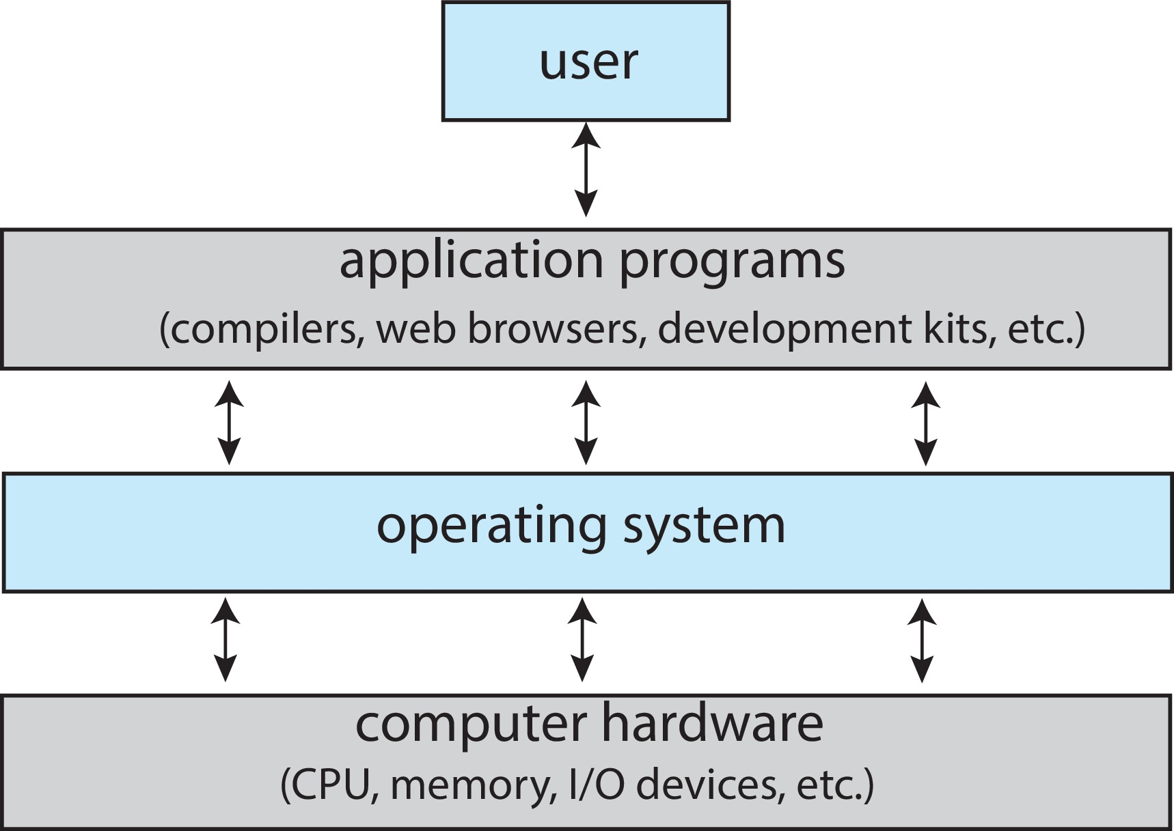
Abstract View of Components of Computer

Slide 8
What Operating Systems Do
Depends on the point of view
Users want convenience, ease of use and good performance
  Don’t care about resource utilization
But shared computer such as mainframe or minicomputer must keep all users happy
  OS is a resource allocator and control program making efficient use of HW and managing execution of user programs

Slide 9
What Operating Systems Do
Users of dedicated systems such as workstations have dedicated resources but frequently use shared resources from servers
Mobile devices like smartphones and tablets are resource-poor, optimized for usability and battery life
  Mobile user interfaces such as touch screens, voice recognition
Some computers have little or no user interface, such as embedded computers in devices and automobiles
  Run primarily without user intervention

Slide 10
Defining Operating Systems
The term OS covers many roles
  Because of myriad designs and uses of OSes
  Present in toasters through ships, spacecraft, game machines, TVs, and industrial control systems
  Born when fixed use computers for military became more general purpose and needed resource management and program control

Slide 11
Operating System Definition
No universally accepted definition
“Everything a vendor ships when you order an operating system” is a good approximation
  But varies wildly
A more common definition: “The one program running at all times on the computer” is the kernel, part of the OS

Slide 12
Operating System Definition
Everything else is either
  A system program (ships with the OS, but not part of the kernel) , or
  An application program, all programs not associated with the OS
Today’s OSes for general purpose and mobile computing also include middleware – a set of software frameworks that provide additional services to application developers such as databases, multimedia, graphics

Slide 13
  Overview of Computer System Structure

Slide 14
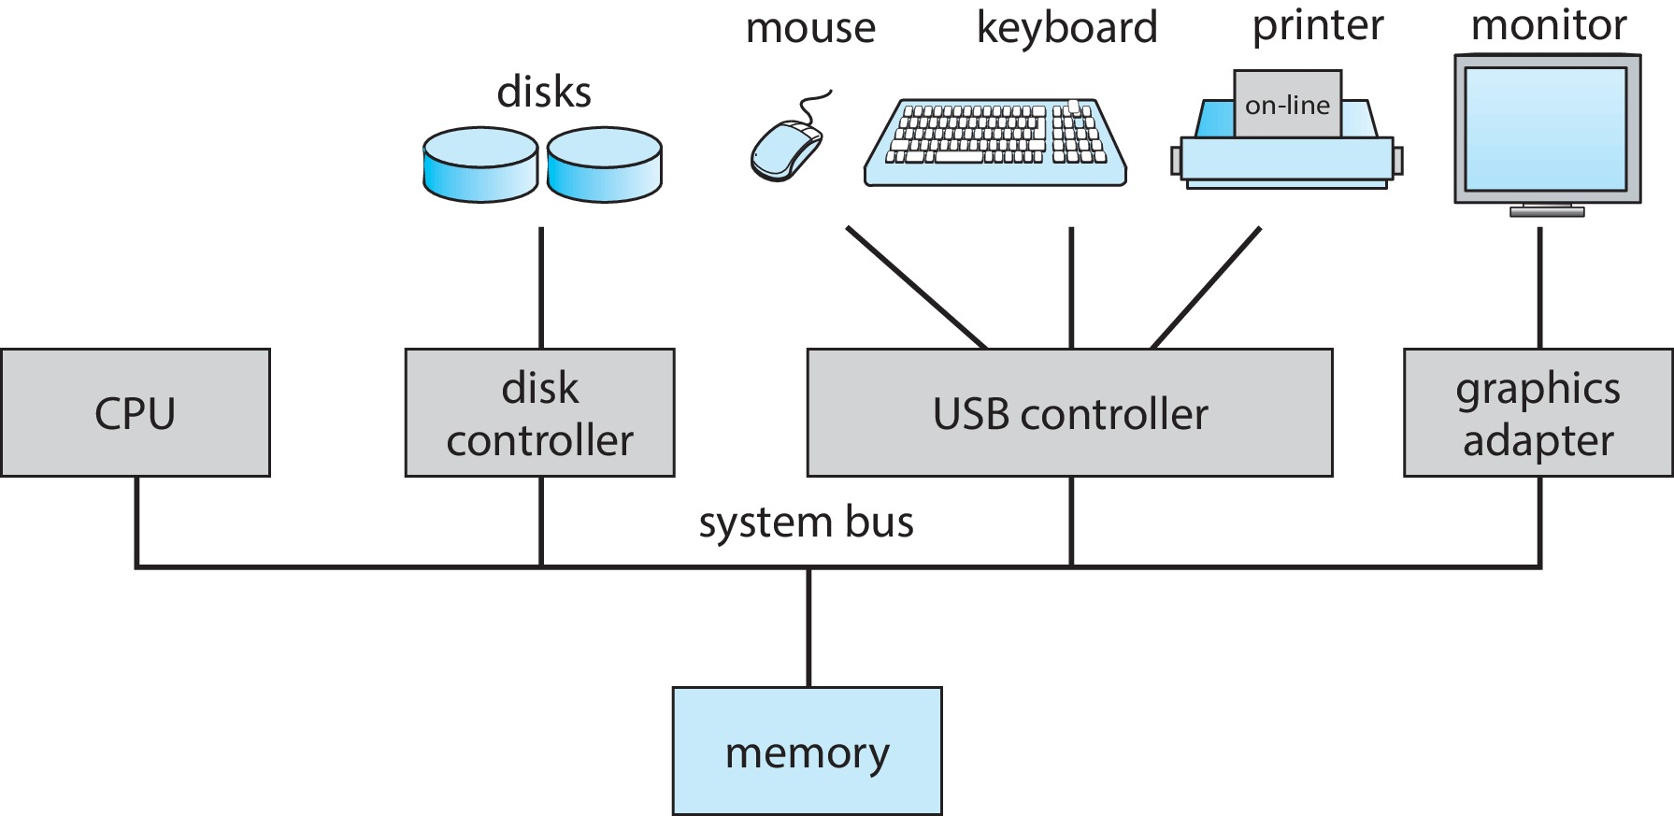
Computer System Organization
Computer-system operation
  One or more CPUs, device controllers connect through common bus providing access to shared memory
  Concurrent execution of CPUs and devices competing for memory cycles

Slide 15
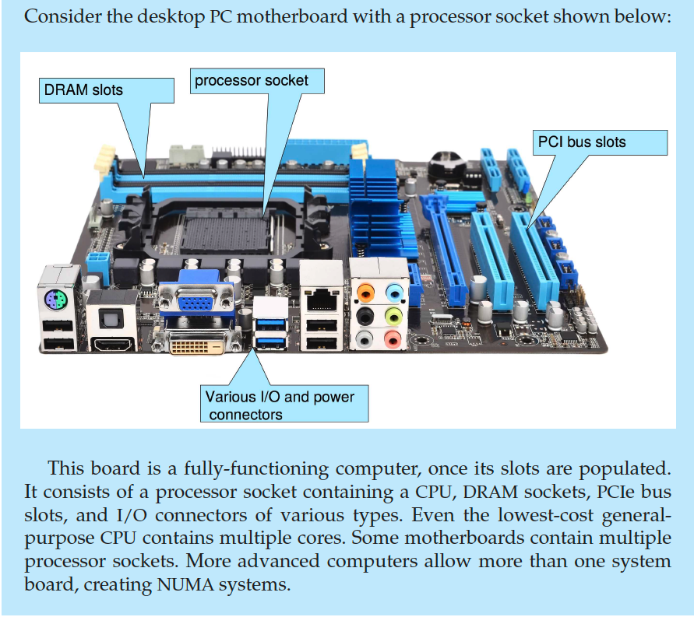
PC Motherboard

Slide 16
Computer-System Operation
I/O devices and CPU can execute concurrently
  Each device controller is in charge of a particular device type
  Each device controller has a local buffer
  Each device controller type has an OS device driver to manage it
I/O is from the device to local buffer of controller
Device controller informs CPU that it has finished its operation by causing an interrupt
CPU moves data from/to main memory to/from local buffers

Slide 17
Common Functions of Interrupts
Interrupt transfers control to the interrupt service routine generally, through the interrupt vector, which contains the addresses of all the service routines
Interrupt architecture must save the address of the interrupted instruction
A trap or exception is a software-generated interrupt caused either by an error or a user request
Modern OS is interrupt-driven

Slide 18
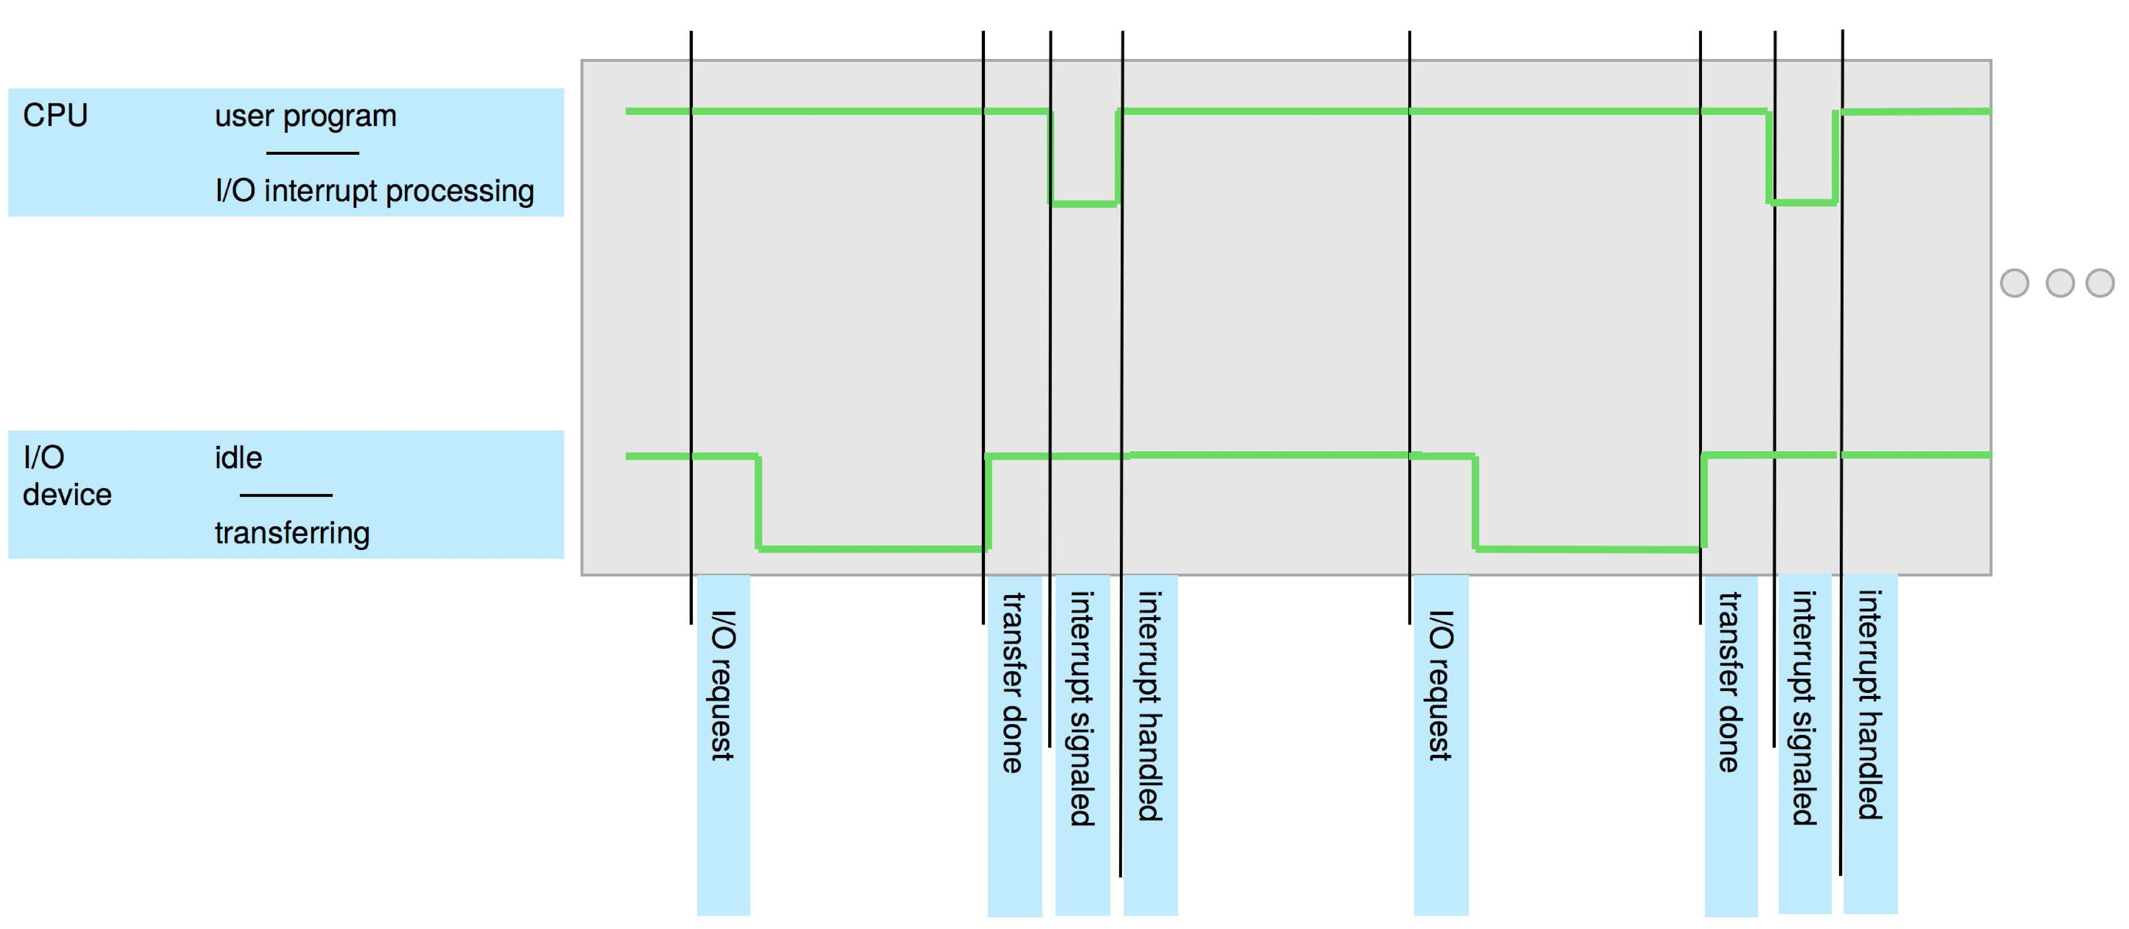
Interrupt Timeline

Slide 19
Interrupt Handling
The OS preserves the state of the CPU by storing the registers and the program counter
Determines which type of interrupt has occurred:
  polling
  vectored interrupt system
Separate segments of code determine what action should be taken for each type of interrupt
    interrupt service routine

Slide 20
Interrupt-driven I/O Cycle

Slide 21
I/O Structure
Two methods for handling I/O
  Synchronous: After I/O starts, control returns to user program only upon I/O completion
  Asynchronous: After I/O starts, control returns to user program without waiting for I/O completion

Slide 22
I/O Structure (Cont.)
Synchronous I/O
  Wait instruction idles the CPU until the next interrupt
  Wait loop (contention for memory access)
  At most one I/O request is outstanding at a time, no simultaneous I/O processing
Asynchronous I/O
  System call – request to the OS to allow user to wait for I/O completion
  Device-status table contains entry for each I/O device indicating its type, address, and state
  OS indexes into I/O device table to determine device status and to modify table entry to include interrupt

Slide 23
  Storage Structure

Slide 24
Storage Structure
Main memory – the only large storage media that CPU can access directly
  Random access
  Typically volatile
  Typically random-access memory in the form of Dynamic Random-access Memory (DRAM)
Secondary storage – extension of main memory that provides large nonvolatile storage capacity

Slide 25
Storage Structure (Cont.)
Hard Disk Drives (HDD) – rigid metal or glass platters covered with magnetic recording material
  Disk surface is logically divided into tracks, which are subdivided into sectors
  The disk controller determines the logical interaction between the device and the computer
Non-volatile memory (NVM) devices – faster than hard disks, nonvolatile
  Various technologies
  Becoming more popular as capacity and performance increases, price drops

Slide 26
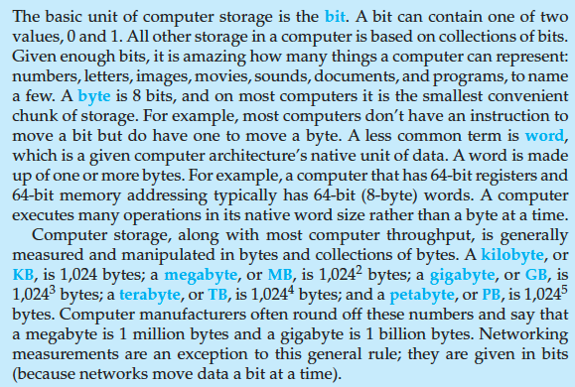
Storage Definitions and Notation Review
The basic unit of computer storage is the bit. A bit can contain one of two
values, 0 and 1. All other storage in a computer is based on collections of bits.
Given enough bits, it is amazing how many things a computer can represent:
numbers, letters, images, movies, sounds, documents, and programs, to name
a few. A byte is 8 bits, and on most computers it is the smallest convenient
chunk of storage. For example, most computers don’t have an instruction to
move a bit but do have one to move a byte. A less common term is word,
which is a given computer architecture’s native unit of data. A word is made
up of one or more bytes. For example, a computer that has 64-bit registers and
64-bit memory addressing typically has 64-bit (8-byte) words. A computer
executes many operations in its native word size rather than a byte at a time.
Computer storage, along with most computer throughput, is generally
measured and manipulated in bytes and collections of bytes. A kilobyte, or
KB , is 1,024 bytes; a megabyte, or MB, is 1,024² bytes; a gigabyte, or GB, is
1,024³ bytes; a terabyte, or TB, is 1,024⁴ bytes; and a petabyte, or PB, is 1,024⁵
bytes. Computer manufacturers often round off these numbers and say that
a megabyte is 1 million bytes and a gigabyte is 1 billion bytes. Networking
measurements are an exception to this general rule; they are given in bits
(because networks move data a bit at a time).

Slide 27
Storage Hierarchy
Storage systems organized in hierarchy
  Speed
  Cost
  Volatility
Caching – copying information into faster storage system
  Main memory can be viewed as a cache for secondary storage
Device Driver for each device controller to manage I/O
  Provides uniform interface between controller and kernel

Slide 28
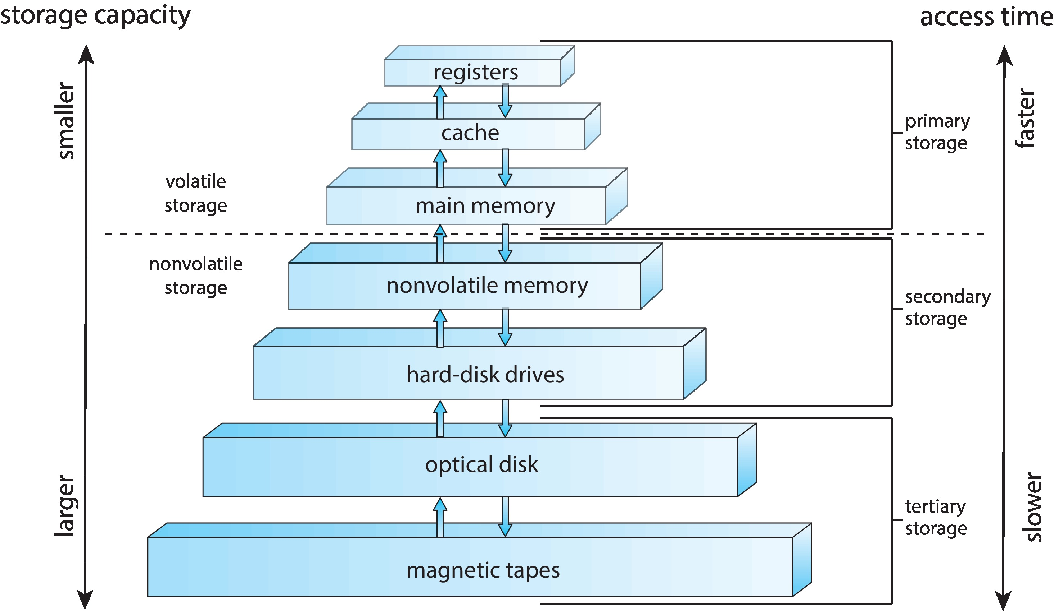
Storage-Device Hierarchy

Slide 29
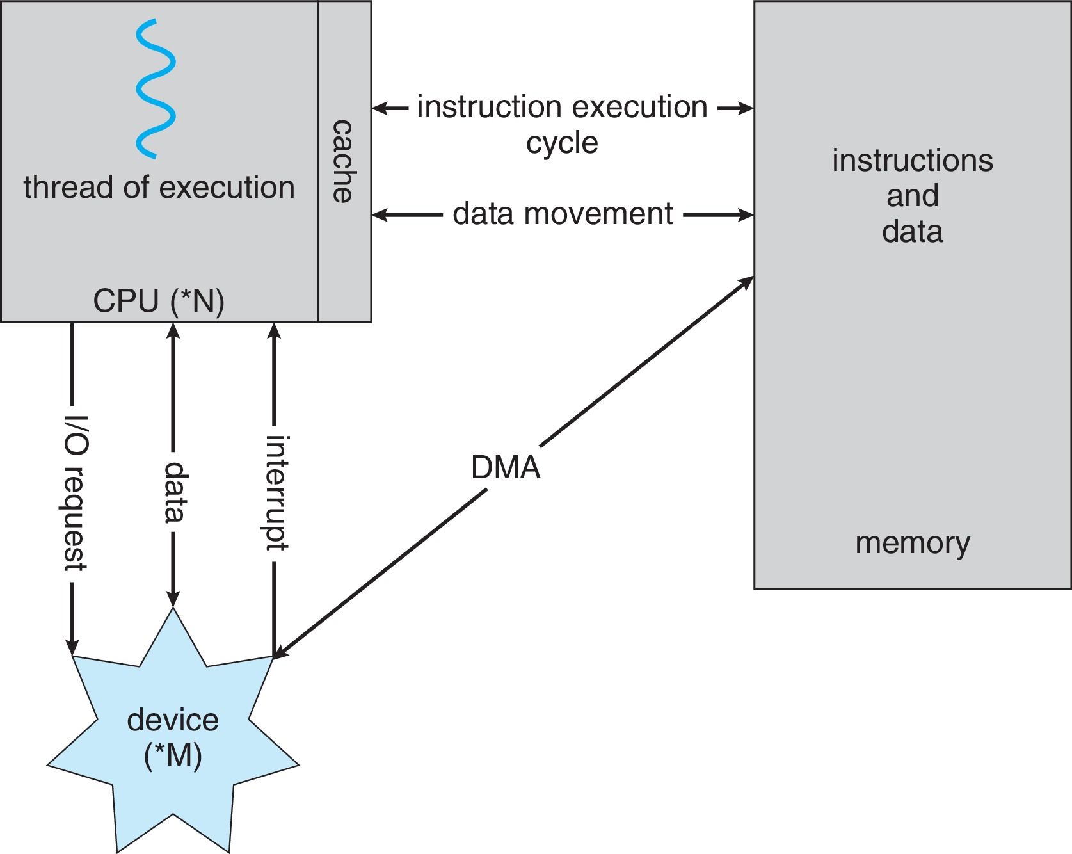
How a Modern Computer Works
A von Neumann architecture

Slide 30
Direct Memory Access Structure
Used for high-speed I/O devices able to transmit information at close to memory speeds
Device controller transfers blocks of data from buffer storage directly to main memory without CPU intervention
Only one interrupt is generated per block, rather than one interrupt per byte

Slide 31
  Operating System Operations

Slide 32
Operating-System Operations
Bootstrap program – simple code to initialize the system, load the kernel
Kernel loads
Starts system daemons (services provided outside of the kernel)
Kernel interrupt driven (hardware and software)
  Hardware interrupt by one of the devices
  Software interrupt (exception or trap):
    Software error (e.g., division by zero)
    Request for OS service – system call
    Other process problems include infinite loop, processes modifying each other or the OS

Slide 33
Multiprogramming (Batch system)
Single user cannot always keep CPU and I/O devices busy
Multiprogramming organizes jobs (code and data) so CPU always has one to execute
A subset of total jobs in system is kept in memory
One job selected and run via job scheduling
When a job has to wait (for I/O for example), OS switches to another job

Slide 34
Multitasking (Timesharing)
A logical extension of Batch systems –CPU switches jobs so frequently that users can interact with each job while it is running, creating interactive computing
  Response time should be < 1 second
  Each user has at least one program executing in memory  process
  If several jobs ready to run at the same time  CPU scheduling
  If processes don’t fit in memory, swapping moves them in and out to run
  Virtual memory allows execution of processes not completely in memory

Slide 35
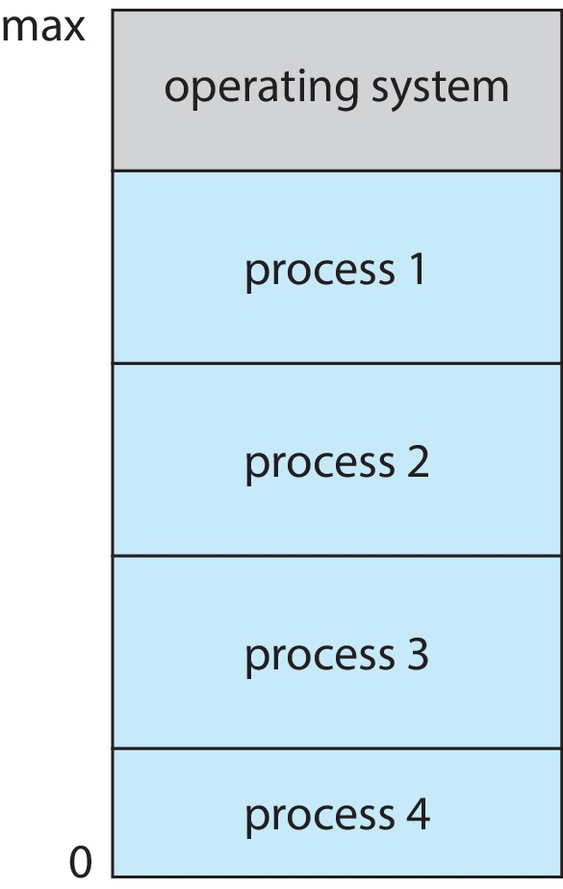
Memory Layout for Multiprogrammed System

Slide 36
Dual-mode Operation
Dual-mode operation allows OS to protect itself and other system components
  User mode and kernel mode
Mode bit provided by hardware
  To distinguish when system is running user code or kernel code
  When a user is running  mode bit is “user”
  When kernel code is executing  mode bit is “kernel”
How do we guarantee that users do not explicitly set the mode bit to “kernel”?
  System call changes mode to kernel, return from call resets it to user
  Some instructions designated as privileged, only executable in kernel mode

Slide 37
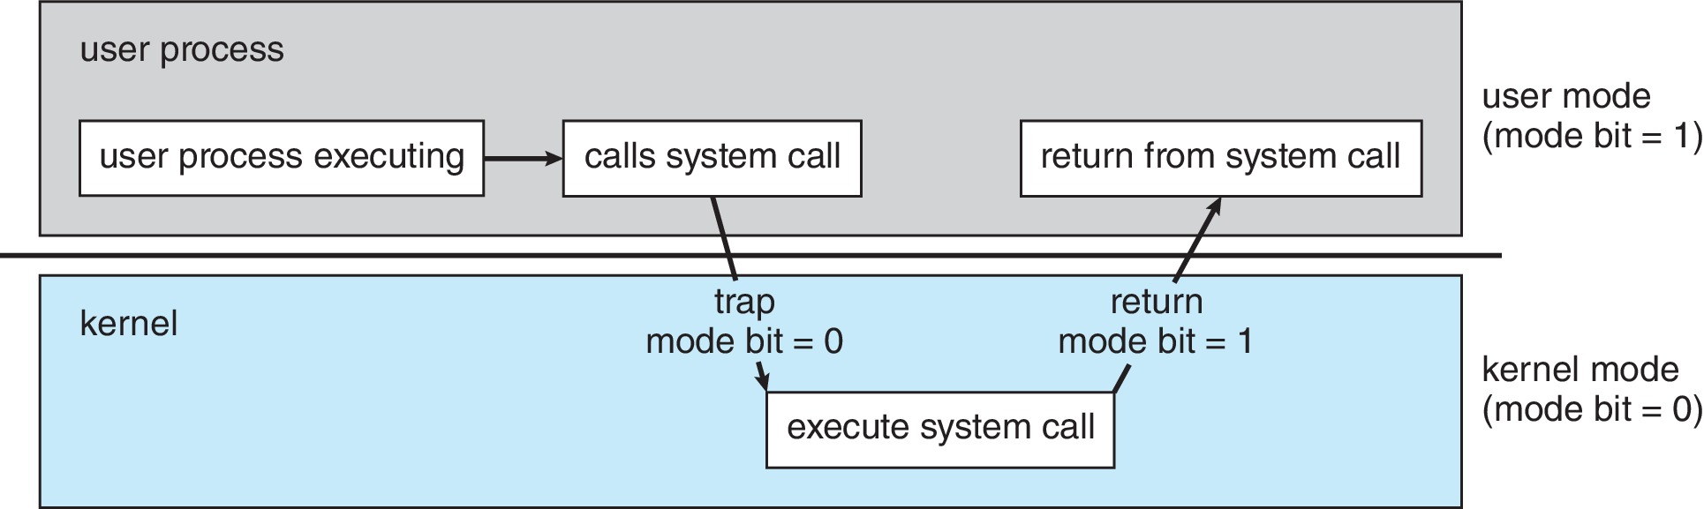
Transition from User to Kernel Mode

Slide 38
Timer
Timer to prevent infinite loop (or process hogging resources)
  Timer is set to interrupt the computer after some time period
  Keep a counter that is decremented by the physical clock
  OS sets the counter (privileged instruction)
  When counter zero, generate an interrupt
  Set up before scheduling process to regain control or terminate program that exceeds allotted time

Slide 39
Process Management
A process is a program in execution
  It is a unit of work within the system
  Program is a passive entity; process is an active entity
Process needs resources to accomplish its task
  CPU, memory, I/O, files
  Initialization data
Process termination requires reclaim of any reusable resources

Slide 40
Process Management
Single-threaded process has one program counter specifying location of the next instruction to execute
  Process executes instructions sequentially, one at a time, until completion
Multi-threaded process has one program counter per thread
Typically system has many processes, (some user, some OS) running concurrently on one or more CPUs
  Concurrency by multiplexing the CPUs among the processes / threads

Slide 41
Process Management Activities
OS is responsible for the following activities in connection with process management:
Creating and deleting both user and system processes
Suspending and resuming processes
Providing mechanisms for process synchronization
Providing mechanisms for process communication
Providing mechanisms for deadlock handling

Slide 42
Memory Management
Von Neumann architecture
  To execute a program, all (or part) of the instructions must be in memory
  All (or part) of the data that is needed by the program must be in memory
Memory management determines what is in memory and when
  Optimizing CPU utilization and computer response to users
Memory management activities
  Keeping track of which parts of memory are currently being used and by whom
  Deciding which processes (or parts thereof) and data to move into and out of memory
  Allocating and deallocating memory space as needed

Slide 43
File-system Management
OS provides uniform, logical view of information storage
  Abstracts physical properties to logical storage unit - file
  Each medium is controlled by device (i.e., disk drive, tape drive)
    Varying properties include access speed, capacity, data-transfer rate, access method (sequential or random)

Slide 44
File-system Management
File-System management
  Files usually organized into directories
  Access control on most systems to determine who can access what
  OS activities include
    Creating and deleting files and directories
    Primitives to manipulate files and directories
    Mapping files onto secondary storage
    Backup files onto stable (non-volatile) storage media

Slide 45
Mass-Storage Management
Usually disks used to store data that do not fit in main memory or data that must be kept for a “long” period of time
Proper management is of central importance
Entire speed of computer operation hinges on disk subsystem and its algorithms

Slide 46
Mass-Storage Management
Storage management activities
  Mounting and unmounting
  Free-space management
  Storage allocation
  Disk scheduling
  Partitioning
  Protection

Slide 47
Caching
Information in use copied from slower to faster storage temporarily
  Important principle, performed at many levels in a computer (in hardware, operating system, software)
Faster storage (cache) checks first to determine if information is there
  If it is, information used directly from the cache (fast)
  If not, data copied to cache and used there
Cache smaller than storage being cached
  Cache management: important design problem
  Cache size and replacement policy

Slide 48
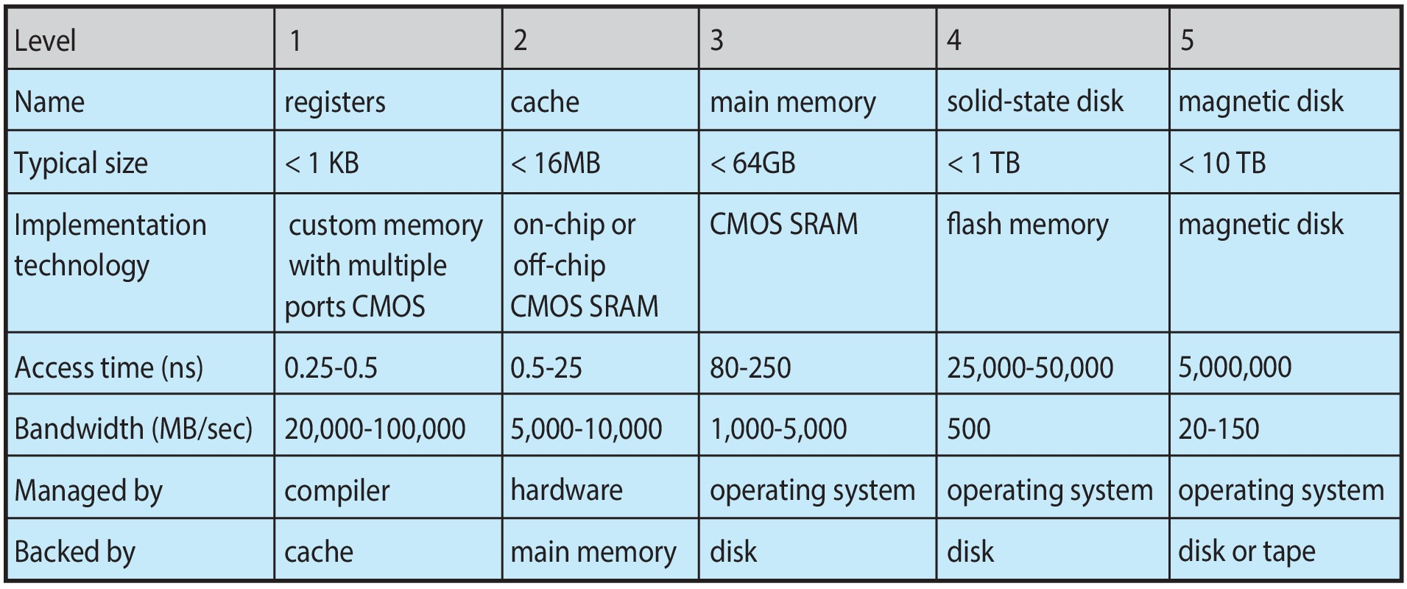
Characteristics of Various Types of Storage
Movement between levels of storage hierarchy can be explicit or implicit

Slide 49
I/O Subsystem
One purpose of OS is to hide peculiarities of hardware devices from the user
I/O subsystem responsible for
  Memory management of I/O including
    buffering (storing data temporarily while it is being transferred)
    caching (storing part of data in faster storage for performance)
    spooling (the overlapping of output of one job with input of other jobs)
  General device-driver interface
  Drivers for specific hardware devices

Slide 50
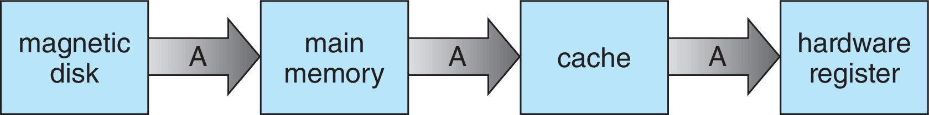
Migration of data “A” from Disk to Register
Multitasking environments must be careful to use most recent value, no matter where it is stored in the storage hierarchy
Multiprocessor environment must provide cache coherency in hardware such that all CPUs have the most recent value in their cache
Distributed environment situation even more complex
  Several copies of a datum can exist
  Various solutions covered in Chap. 19

Slide 51
Protection and Security
Protection – any mechanism for controlling access of processes or users to resources defined by the OS
Security – defense against internal and external attacks
  Huge range, including denial-of-service, worms, viruses, identity theft, theft of service
Systems generally first distinguish among users, to determine who can do what
  User identities (user IDs, security IDs) include name and associated number, one per user
  User ID then associated with all files, processes of that user to determine access control
  Group identifier (group ID) allows set of users to be defined and controls managed, then also associated with each process, file
  Privilege escalation allows user to change to effective ID with more rights

Slide 52
Virtualization
Allows OS to run applications within other OSes
  Vast and growing industry
Emulation used when source CPU type different from target type (i.e. PowerPC to Intel x86)
  Generally slowest method
  When computer language not compiled to native code – Interpretation
Virtualization – OS natively compiled for CPU, running guest OSes also natively compiled
  Consider VMware running Win10 guests, each running applications, all on native Win10 host OS
  VMM (virtual machine manager) provides virtualization services

Slide 53
Virtualization (cont.)
Use cases involve laptops and desktops running multiple OSes for exploration or compatibility
  Apple laptop running Mac OS X host, Windows as a guest
  Developing apps for multiple OSes without having multiple systems
  Quality assurance testing applications without having multiple systems
  Executing and managing compute environments within data centers
VMM can run natively, in which case they are also the host
  There is no general-purpose host then (VMware ESX and Citrix XenServer)

Slide 54
Computing Environments - Virtualization

Slide 55
  Computer System Architecture

Slide 56
Computer-System Architecture
Most systems use a single general-purpose processor
  Most systems have special-purpose processors as well
Multiprocessors systems growing in use and importance
  Also known as parallel systems, tightly-coupled systems
  Advantages include:
    Increased throughput
    Economy of scale
    Increased reliability – graceful degradation or fault tolerance
  Two types:
    Asymmetric Multiprocessing – each processor is assigned a specific task
    Symmetric Multiprocessing – each processor performs all tasks

Slide 57
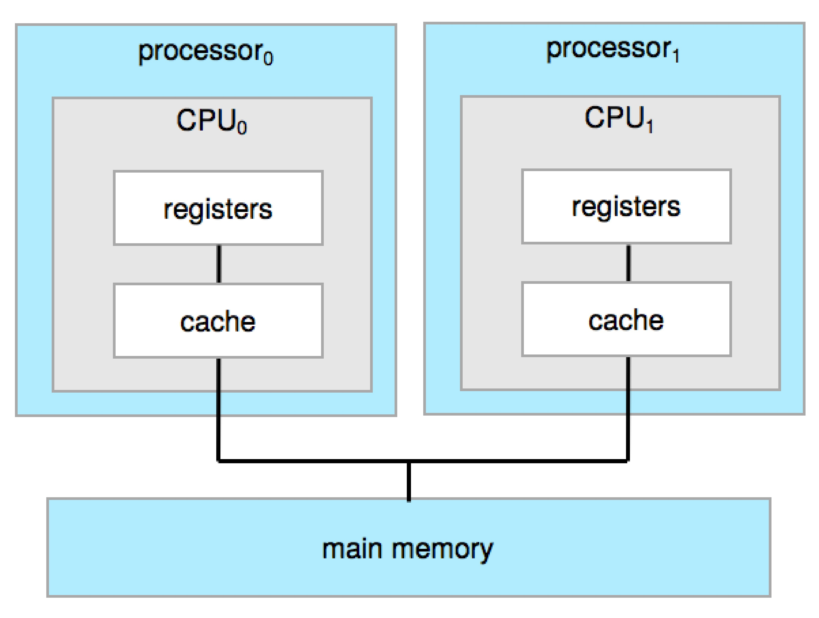
Symmetric Multiprocessing Architecture

Slide 58
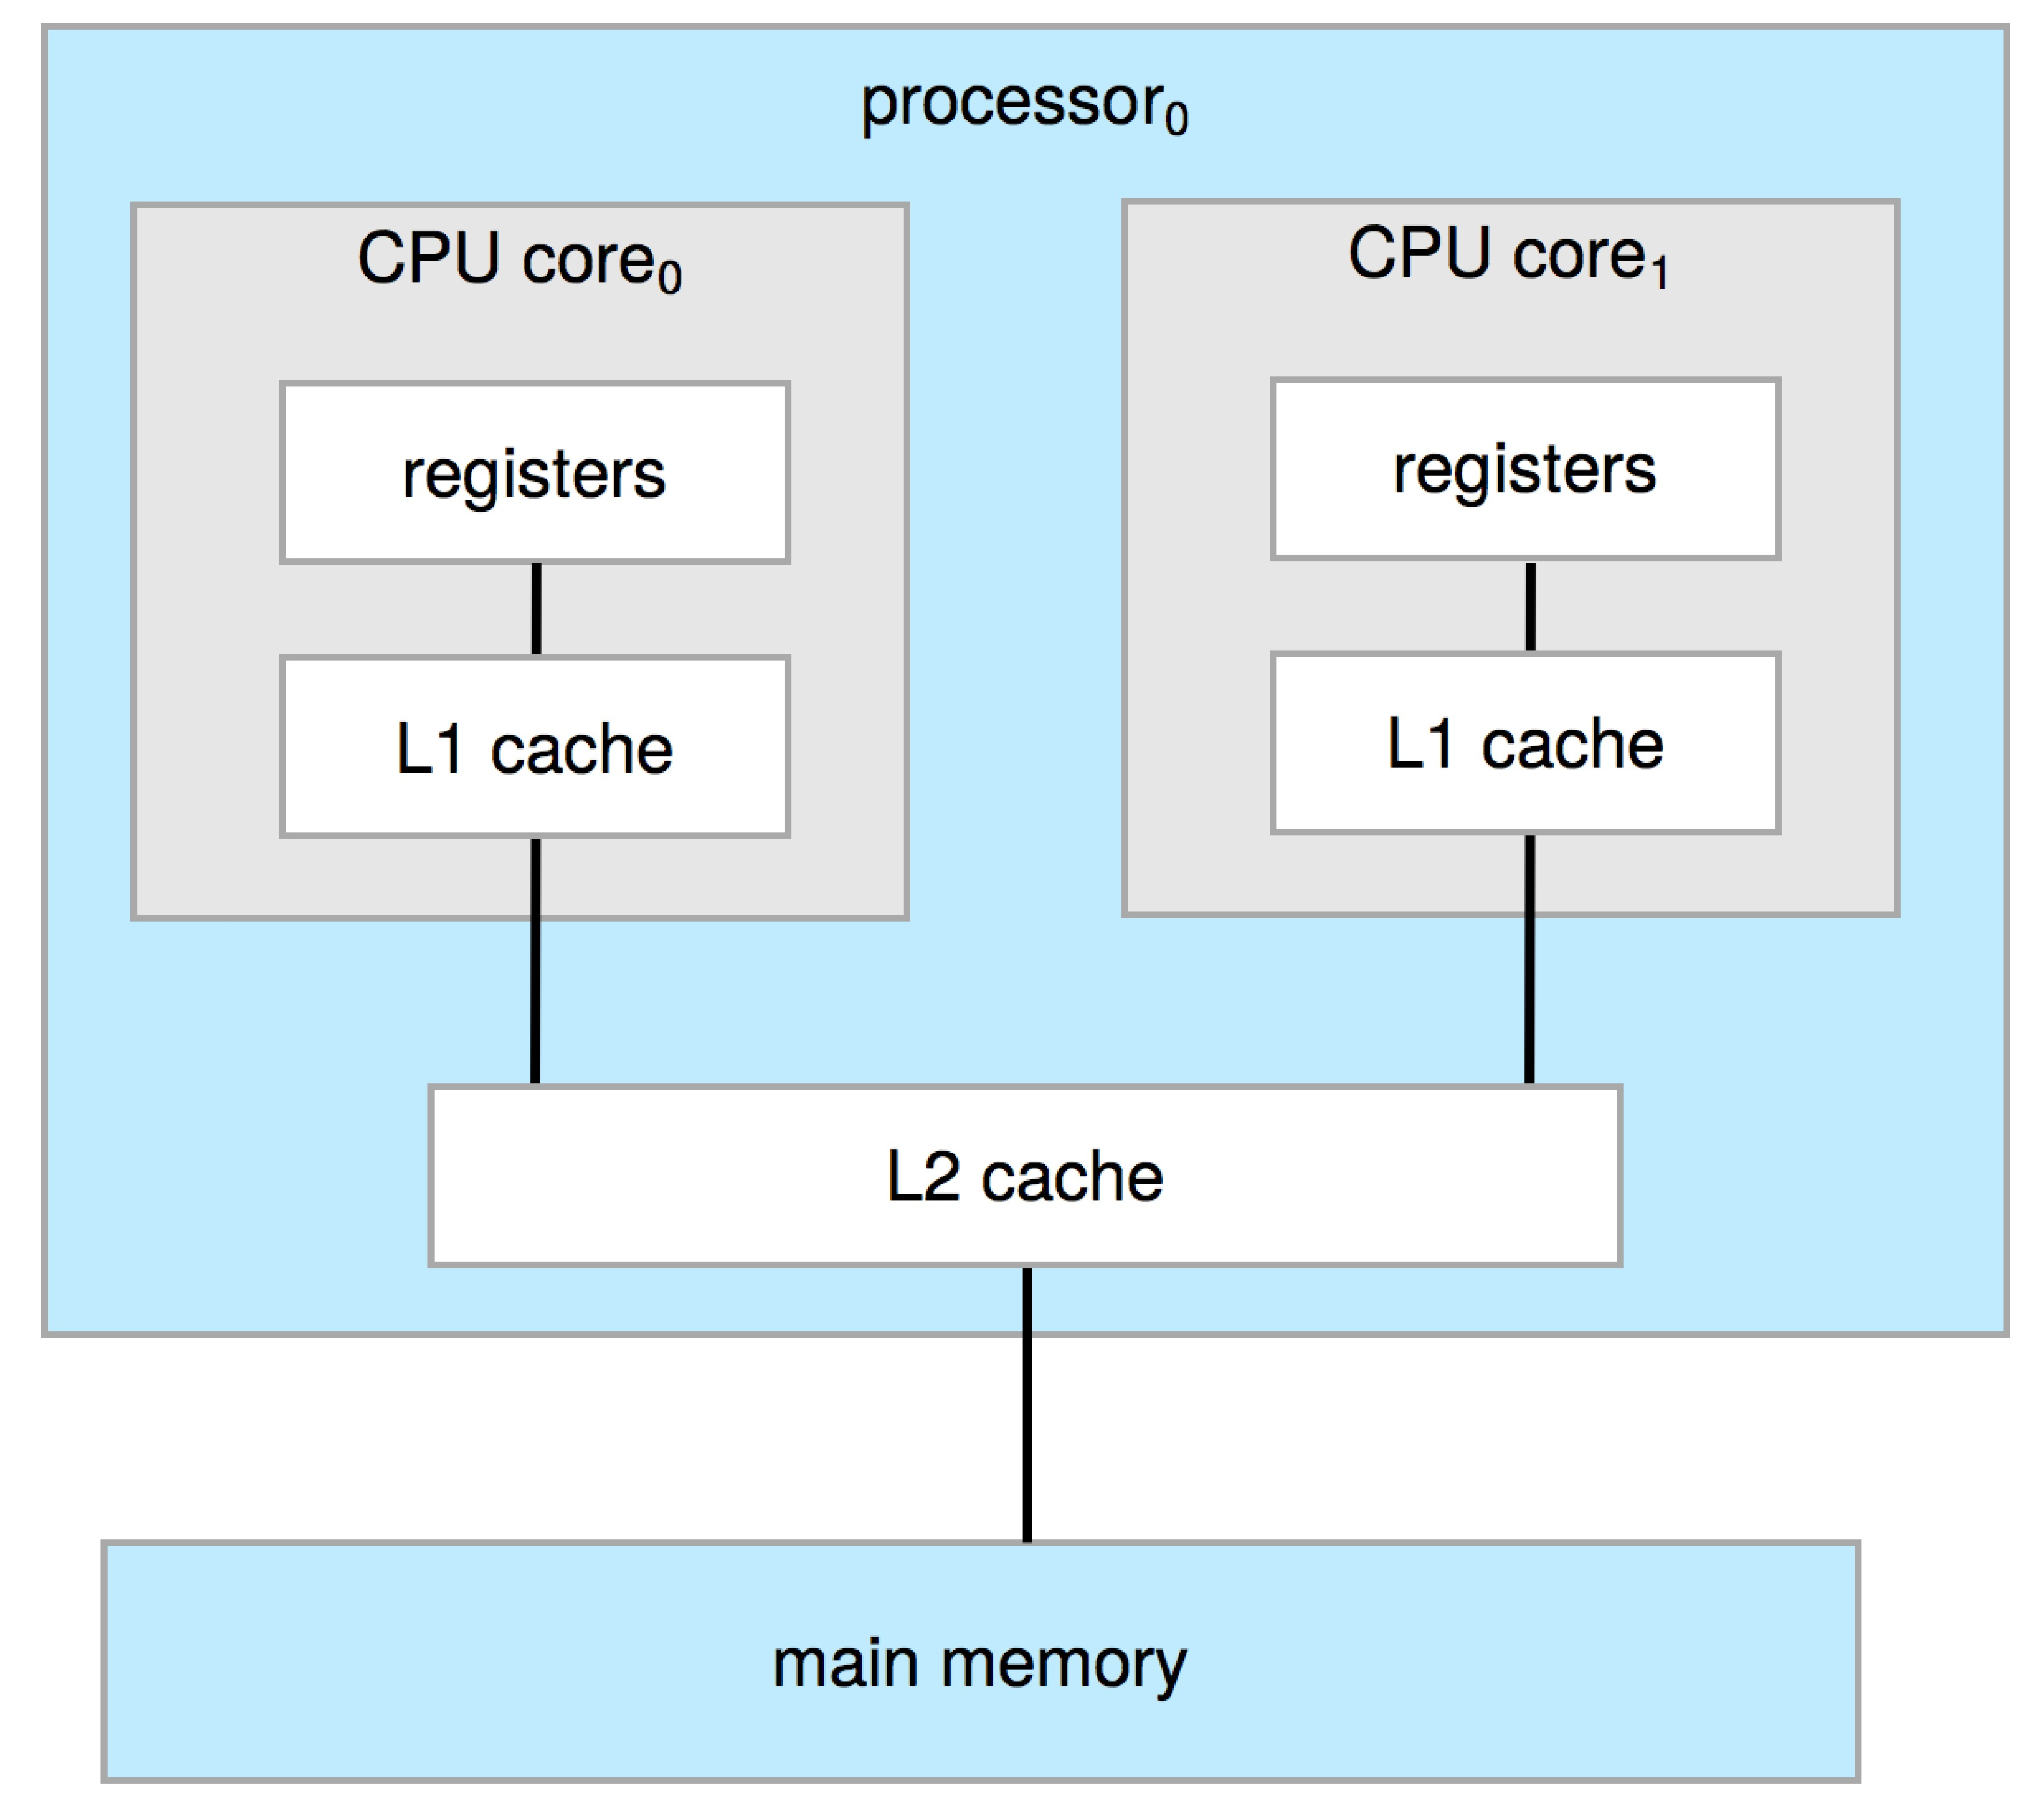
Dual-Core Design
Multi-chip and multicore
Systems containing all chips
  Chassis containing multiple separate systems

Slide 59
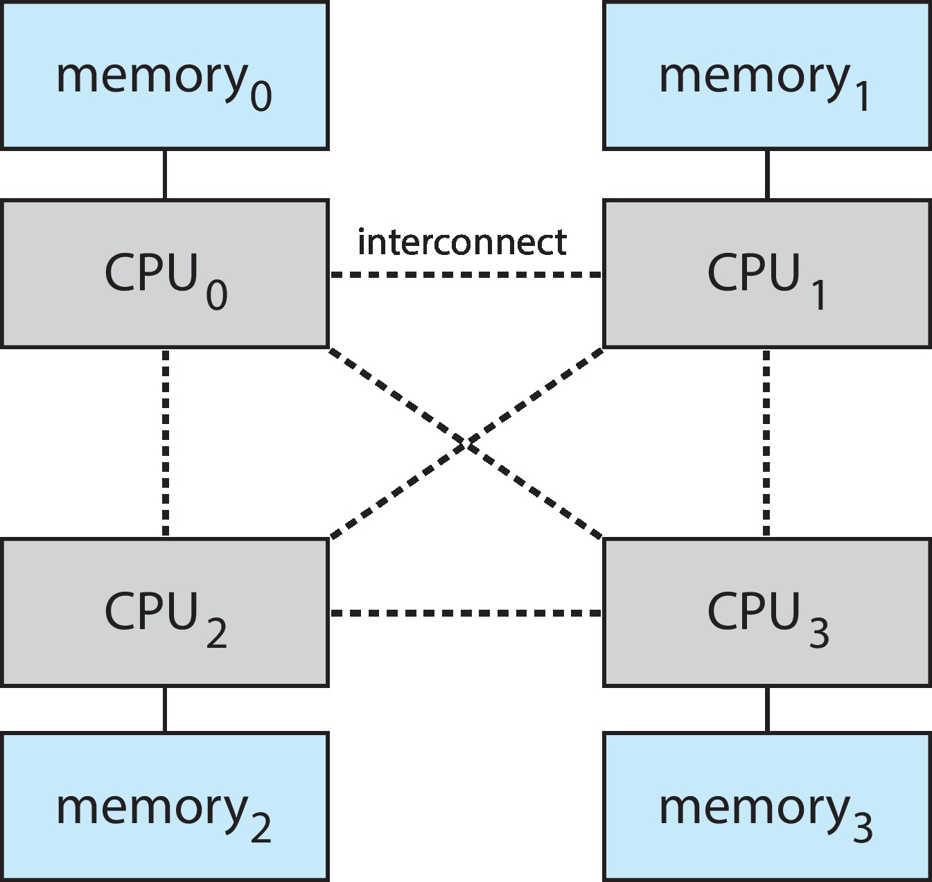
Non-Uniform Memory Access System

Slide 60
Clustered Systems
Like multiprocessor systems, but multiple systems working together
  Usually sharing storage via a storage-area network (SAN)
  Provides a high-availability service which survives failures
    Asymmetric clustering has one machine in hot-standby mode
    Symmetric clustering has multiple nodes running applications, monitoring each other
  Some clusters are for high-performance computing (HPC)
    Applications must be written to use parallelization
  Some have distributed lock manager (DLM) to avoid conflicting operations

Slide 61
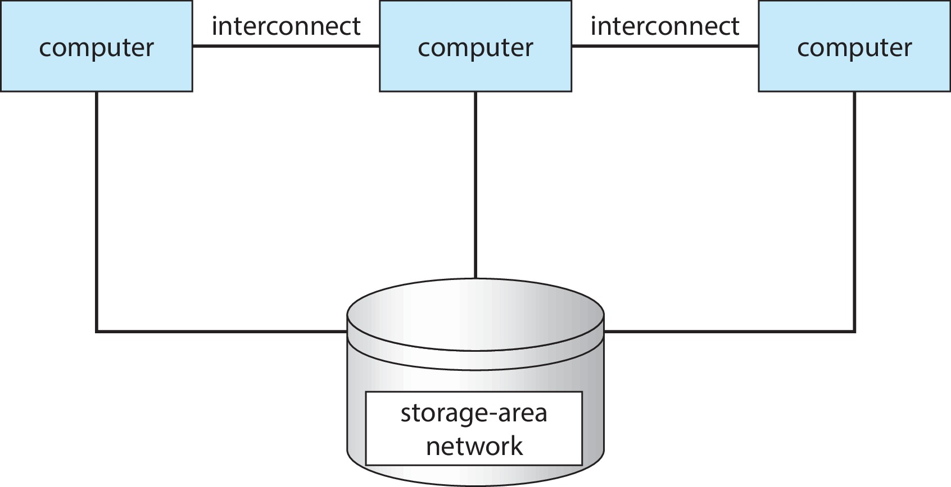
Clustered Systems

Slide 62
  Computer System Environments

Slide 63
Computing Environments
Traditional
Mobile
Client-Server
Pear-to-Pear
Cloud computing
Real-time Embedded

Slide 64
Traditional
Stand-alone general-purpose machines
  But blurred as most systems interconnect with others (i.e., the Internet)
Portals provide web access to internal systems
Network computers (thin clients) are like Web terminals
Mobile computers interconnect via wireless networks
Networking becoming ubiquitous – even home systems use firewalls to protect home computers from Internet attacks

Slide 65
Mobile
Handheld smartphones, tablets, etc.
What is the functional difference between them and a “traditional” laptop?
  Extra feature – more OS features (GPS, gyroscope)
Allows new types of apps like augmented reality
Use IEEE 802.11 wireless, or cellular data networks for connectivity
Leaders are Apple iOS and Google Android

Slide 66
Client Server
Client-Server Computing
  Dumb terminals supplanted by smart PCs
  Many systems now servers, responding to requests generated by clients
    Compute-server system provides an interface to client to request services (i.e., database)
    File-server system provides interface for clients to store and retrieve files

Slide 67
Peer-to-Peer
Another model of distributed system
P2P does not distinguish clients and servers
  All nodes are considered peers
  Each acts as client, server, or both
  Node must join P2P network
    Registers its service with central lookup service on network, or
    Broadcast request for service and respond to requests for service via discovery protocol
  Examples include Napster and Gnutella, Voice over IP (VoIP) such as Skype

Slide 68
Cloud Computing
Delivers computing, storage, even apps as a service across a network
Logical extension of virtualization because it uses virtualization as the base for its functionality
  Amazon EC2 has thousands of servers, millions of virtual machines, petabytes of storage available across the Internet, pay based on usage

Slide 69
Cloud Computing (Cont.)
Many types
  Public cloud – available via Internet to anyone willing to pay
  Private cloud – run by a company for the company’s own use
  Hybrid cloud – includes both public and private cloud components
  Software as a Service (SaaS) – one or more applications available via the Internet (i.e., word processor)
  Platform as a Service (PaaS) – software stack ready for application use via the Internet (i.e., a database server)
  Infrastructure as a Service (IaaS) – servers or storage available over Internet (i.e., storage available for backup use)

Slide 70
Cloud Computing (cont.)
Cloud computing environments composed of traditional OSes, plus VMMs, plus cloud management tools
  Internet connectivity requires security like firewalls
  Load balancers spread traffic across multiple applications

Slide 71
Real-Time Embedded Systems
Real-time embedded systems most prevalent form of computers
  Vary considerably, special purpose, limited purpose OS, real-time OS
  Use expanding
Many other special computing environments as well
  Some have OSes
  Some perform tasks without an OS
Real-time OS has well-defined fixed time constraints
  Processing must be done within constraint
  Correct operation only if constraints met

Slide 72
Free and Open-Source Operating Systems
Operating systems made available in source-code format rather than just binary closed-source and proprietary
Counter to the copy protection and Digital Rights Management (DRM) movement
Started by Free Software Foundation (FSF), which has “copyleft” GNU Public License (GPL)
  Free software and open-source software are two different ideas championed by different groups of people
    http://gnu.org/philosophy/open-source-misses-the-point.html/

Slide 73
Free and Open-Source Operating Systems
Examples include GNU/Linux and BSD UNIX (including core of Mac OS X), and many more
Can use VMM like
  VMware Player (Free on Windows)
  Virtualbox (open source and free on many platforms - http://www.virtualbox.com)
Used to run guest OS for exploration

Slide 74
The Study of Operating Systems
There has never been a more interesting time to study operating systems, and it has never been
easier. The open-source movement has overtaken operating systems, causing many of them to be
made available in both source and binary (executable) format. The list of operating
systems available in both formats includes Linux, BUSD UNIX, Solaris, and part of macOS.
The availability of source code allows us to study operating systems from the inside out.
Questions that we could once answer only by looking at documentation or the behavior of an
operating system we can now answer by examining the code itself.
Operating systems that are no longer commercially viable have been open-sourced as well, enabling
us to study how systems operated in a time of fewer CPU, memory, and storage resources.
An extensive but incomplete list of open-source operating-system projects is available
from https://curlie.org/Computers/Software/Operating_Systems/Open_Source/
In addition, the rise of virtualization as a mainstream (and frequently free) computer function
makes it possible to run many operating systems on top of one core system. For example, VMware
(http://www.vmware.com) provides a free “player” for Windows on which hundreds of free
“virtual appliances” can run. Virtualbox (http://www.virtualbox.com) provides a free, open-source
virtual machine manager on many operating systems. Using such tools, students can try out
hundreds of operating systems without dedicated hardware.
The advent of open-source operating systems has also made it easier to make the move from
student to operating-system developer. With some knowledge, some effort, and an Internet
connection, a student can even create a new operating-system distribution. Just a few years ago,
it was difficult or impossible to get access to source code. Now, such access is limited only by
how much interest, time, and disk space a student has.

Slide 75
End of Chapter 1

Slide 76
Kernel Data Structures
Many similar to standard programming data structures
Singly linked list
Doubly linked list
Circular linked list

Slide 77
Kernel Data Structures
Binary search tree
left <= right
  Search performance is O(n)
  Balanced binary search tree is O(lg n)

Slide 78
Kernel Data Structures
Hash function can create a hash map
Bitmap – string of n binary digits representing the status of n items
Linux data structures defined in include files <linux/list.h>, <linux/kfifo.h>, <linux/rbtree.h>

Slide 79
Computer Startup
Bootstrap program is loaded at power-up or reboot
  Typically stored in ROM or EPROM, generally known as firmware
  Initializes all aspects of system
  Loads operating system kernel and starts execution

Slide 80
Characteristics of Various Types of Storage
Movement between levels of storage hierarchy can be explicit or implicit

