Slide 1
Modified from Stanford CS276 slides
Chap. 5: Index Compression

Slide 2
Last lecture – index construction
Sort-based indexing
  Naïve in-memory inversion
  Blocked Sort-Based Indexing
    Merge sort is effective for disk-based sorting (avoid seeks!)
Single-Pass In-Memory Indexing
  No global dictionary
    Generate separate dictionary for each block
  Don’t sort postings
    Accumulate postings in postings lists as they occur
Distributed indexing using MapReduce
Dynamic indexing: Multiple indices, logarithmic merge

Slide 3
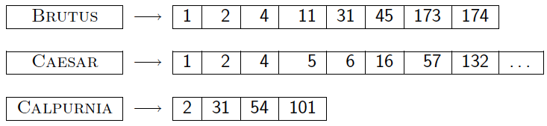
Today
Ch. 5
Collection statistics in more detail (with RCV1)
  How big will the dictionary and postings be?
Dictionary compression (skimmed)
Postings compression (skimmed)

Slide 4
Why compression (in general)?
Ch. 5
Use less disk space
  Saves a little money
Keep more stuff in memory
  Increases speed
Increase speed of data transfer from disk to memory
  [read compressed data | decompress] is faster than [read uncompressed data]
  Premise: Decompression algorithms are fast
    True of the decompression algorithms we use

Slide 5
Why compression for inverted indexes?
Ch. 5
Dictionary
  Make it small enough to keep in main memory
  Make it so small that you can keep some postings lists in main memory too
Postings file(s)
  Reduce disk space needed
  Decrease time needed to read postings lists from disk
  Large search engines keep a significant part of the postings in memory
    Compression lets you keep more in memory
We will devise various IR-specific compression schemes

Slide 6
Recall Reuters RCV1
Sec. 5.1
symbol statistic value
N documents 800,000
L avg. # tokens per doc 200
M terms (= word types) ~400,000
avg. # bytes per token 6
  (incl. spaces/punct.)
avg. # bytes per token 4.5
    (without spaces/punct.)
avg. # bytes per term 7.5
T non-positional postings 100,000,000

Slide 7
Index parameters vs. what we index
(IIR Table 5.1, p.80)
Sec. 5.1
size of | word types (terms) |  |  | non-positional postings |  |  | positional postings
 | dictionary |  |  | non-positional index |  |  | positional index
 | Size (K) | ∆% | cumul % | Size (K) | ∆ % | cumul % | Size (K) | ∆ % | cumul %
Unfiltered | 484 |  |  | 109,971 |  |  | 197,879
No numbers | 474 | -2 | -2 | 100,680 | -8 | -8 | 179,158 | -9 | -9
Case folding | 392 | -17 | -19 | 96,969 | -3 | -12 | 179,158 | 0 | -9
30 stopwords | 391 | -0 | -19 | 83,390 | -14 | -24 | 121,858 | -31 | -38
150 stopwords | 391 | -0 | -19 | 67,002 | -30 | -39 | 94,517 | -47 | -52
stemming | 322 | -17 | -33 | 63,812 | -4 | -42 | 94,517 | 0 | -52
Exercise: give intuitions for all the ‘0’ entries. Why do some zero entries correspond to big deltas in other columns?

Slide 8
Lossless vs. lossy compression
Sec. 5.1
Lossless compression: All information is preserved
  What we mostly do in IR
Lossy compression: Discard some information
Several of the preprocessing steps can be viewed as lossy compression: case folding, stop words, stemming, number elimination
In Chap.7: Prune postings entries that are unlikely to turn up in the top k list for any query
  Almost no loss quality for top k list

Slide 9
Vocabulary vs. collection size
Sec. 5.1
How big is the term vocabulary?
  That is, how many distinct words are there?
Can we assume an upper bound?
  Not really: At least 70²⁰ = 10³⁷ different words of length 20
In practice, the vocabulary will keep growing with the collection size
  Especially with Unicode ☺
Notes:
Also - the calculation "At least 7020 = 1037 different words of length 20" seems like a bit of a gross overestimate (and in any case, might be more useful to say it's 2 raised to some power rather than 10 raised to the power 37)

Slide 10
Vocabulary vs. collection size
Sec. 5.1
Heaps’ law: M = kT^{b}
  M is the size of the vocabulary, T is the number of tokens in the collection
  Typical values: 30 ≤ k ≤ 100 and b ≈ 0.5
In a log-log plot of vocabulary size M vs. T, Heaps’ law predicts a line with slope about ½
  It is the simplest possible relationship between the two in log-log space
  An empirical finding (“empirical law”) in 1978

Slide 11
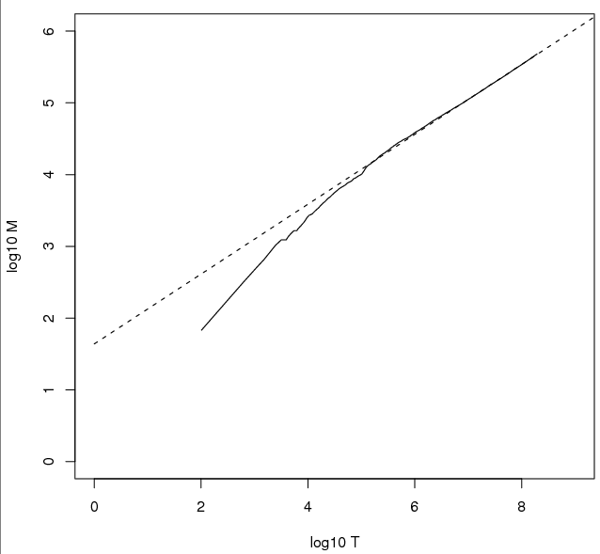
Heaps’ Law
Sec. 5.1
Fig 5.1, p.83
For RCV1, the dashed line
log₁₀M = 0.49 log₁₀T + 1.64 is the best least squares fit.
Thus, M = 10^{1.64}T^{0.49} so k = 10^{1.64} ≈ 44 and b = 0.49.
Good empirical fit for Reuters RCV1 !
For first 1,000,020 tokens,
law predicts 38,323 terms;
actually, 38,365 terms
Notes:
Example: for the first 1,000,020 tokens Heaps’ law predicts
38,323 terms:
44 Å~ 1,000,0200.49 ≈ 38,323
The actual number is 38,365 terms, very close to the
prediction.
Empirical observation: fit is good in general.

Slide 12
Exercises
Sec. 5.1
What is the effect of including spelling errors, vs. automatically correcting spelling errors on Heaps’ law?
Compute the vocabulary size M for this scenario:
  Looking at a collection of web pages, you find that there are 3,000 different terms in the first 10,000 tokens and 30,000 different terms in the first 1,000,000 tokens
  Assume a search engine indexes a total of 20,000,000,000 (2 × 10¹⁰) pages, containing 200 tokens on average
  What is the size of the vocabulary of the indexed collection as predicted by Heaps’ law?

Slide 13
Zipf’s law (1949)
Sec. 5.1
Heaps’ law gives the vocabulary size in collections
  We also study the relative frequencies of terms
  In natural language, there are a few very frequent terms and very many very rare terms
Zipf’s law: The ith most frequent term has frequency proportional to 1/i
  cf_{i} ∝ 1/i = K/i where K is a normalizing constant
  cf_{i} is collection frequency: the number of occurrences of the term t_{i} in the collection

Slide 14
Zipf consequences
Sec. 5.1
If the most frequent term (the) occurs cf₁ times
  then the second most frequent term (of) occurs cf₁/2 times
  the third most frequent term (and) occurs cf₁/3 times …
Equivalent: cf_{i} = K/i where K is a normalizing factor, so
  log cf_{i} = log K - log i
  Linear relationship between log cf_{i} and log i
Another power law relationship

Slide 15
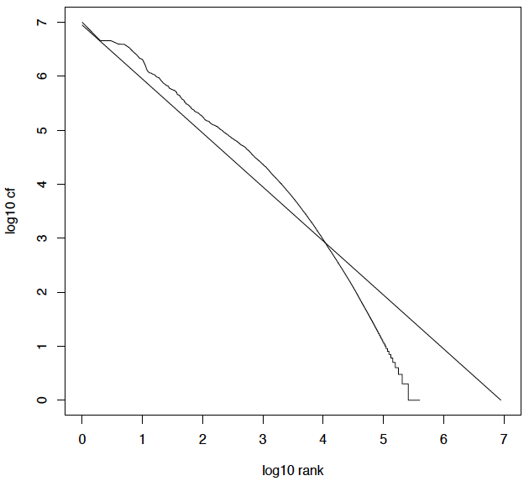
Zipf’s law for Reuters RCV1
Sec. 5.1
log cf_{i}=log K - log i
vs.
A line with slope -1

Slide 16
Compression
Ch. 5
Now, we will consider compressing the space for the dictionary and postings
  Basic Boolean index only
  No study of positional indexes, etc.
  We will consider compression schemes

Slide 17
DICTIONARY COMPRESSION
Sec. 5.2

Slide 18
Why compress the dictionary?
Sec. 5.2
Search begins with the dictionary
We want to keep it in memory
Memory footprint competition with other applications
Embedded/mobile devices may have very little memory
Even if the dictionary isn’t in memory, we want it to be small for a fast search startup time
So, compressing the dictionary is important

Slide 19
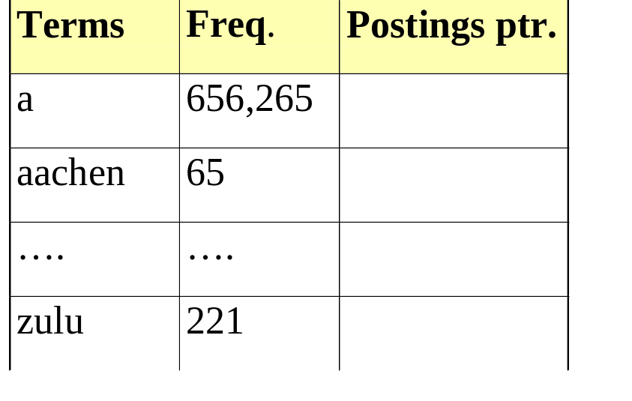
Dictionary storage - first cut
Sec. 5.2
Array of fixed-width entries
  ~400,000 terms; 28 bytes/term = 11.2 MB
Dictionary search
structure
20 bytes
4 bytes each

Slide 20
Fixed-width terms are wasteful
Sec. 5.2
Most of the bytes in the Term column are wasted – we allot 20 bytes for 1 letter terms
  And we still can’t handle supercalifragilisticexpialidocious or hydrochlorofluorocarbons.
Written English averages ~4.5 characters/word
  Exercise: Why is/isn’t this the number to use for estimating the dictionary size?
Ave. dictionary word in English: ~8 characters
  How do we use ~8 characters per dictionary term?
Short words dominate token counts but not type average

Slide 21
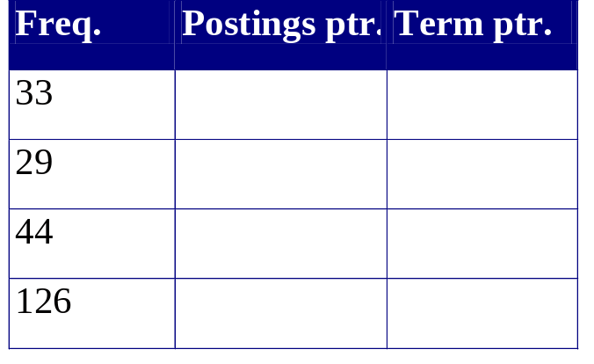
Compressing the term list:
Dictionary-as-a-String
Sec. 5.2
Store dictionary as a (long) string of characters:
  Pointer to next word shows end of current word
  Hope to save up to 60% of dictionary space
….systilesyzygeticsyzygialsyzygyszaibelyiteszczecinszomo….
Total string length =
400K x 8B = 3.2MB
Pointers resolve 3.2M
positions: log₂3.2M =
22bits = 3bytes

Slide 22
Space for dictionary as a string
Sec. 5.2
4 bytes per term for Freq.
4 bytes per term for pointer to Postings
3 bytes per term pointer
Avg. 8 bytes per term in term string
400K terms x 19 ⇒ 7.6 MB (against 11.2MB for fixed width)
⎫ Now avg. 11
⎬ bytes/term,
⎭ not 20

Slide 23
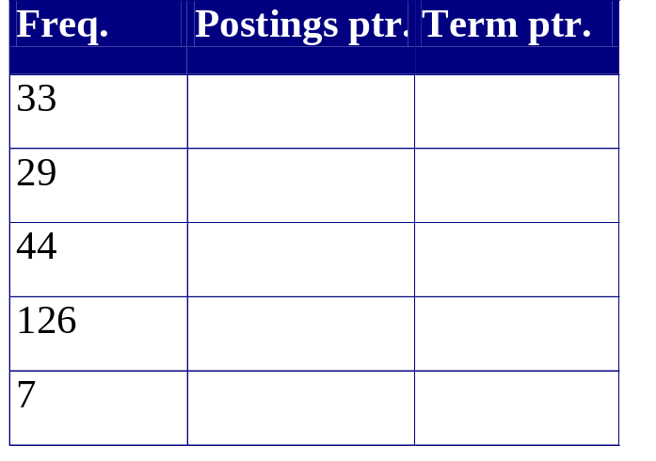
Blocking
Sec. 5.2
Store pointers to every kth term string
  Example below: k=4
Need to store term lengths (1 extra byte)
….7systile9syzygetic8syzygial6syzygy11szaibelyite8szczecin9szomo….
⎫ Save 9 bytes
⎬ on 3
⎭ pointers
Lose 4 bytes on
term lengths

Slide 24
Net
Sec. 5.2
Example for block size k = 4
Where we used 3 bytes/pointer without blocking
  3 x 4 = 12 bytes,
now we use 3 + 4 = 7 bytes
Shaved another ~0.5MB. This reduces the size of the dictionary from 7.6 MB to 7.1 MB
We can save more with larger k
Why not go with larger k?

Slide 25
Exercise
Sec. 5.2
Estimate the space usage (and savings compared to 7.6 MB) with blocking, for block sizes of k = 4, 8 and 16

Slide 26
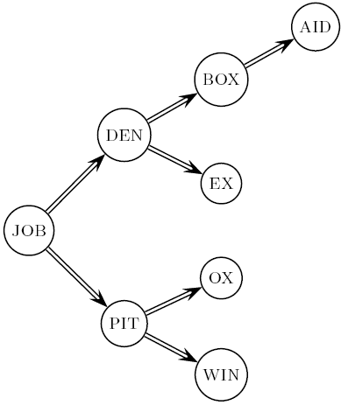
Dictionary search without blocking
Sec. 5.2
Assuming each dictionary term equally likely in query (not really so in practice!), average number of comparisons = (1+2∙2+4∙3+4)/8 ~2.6
Exercise: what if the frequencies of query terms were non-uniform but known, how would you structure the dictionary search tree?

Slide 27
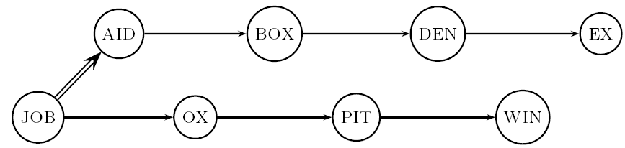
Dictionary search with blocking
Sec. 5.2
Binary search down to 4-term block;
  Then linear search through terms in block
Blocks of 4 (binary tree), avg. = (1+2∙2+2∙3+2∙4+5)/8 = 3 compares

Slide 28
Exercise
Sec. 5.2
Estimate the impact on search performance (and slowdown compared to k=1) with blocking, for block sizes of k = 4, 8 and 16

Slide 29
Front coding
Sec. 5.2
Front-coding:
  Sorted words commonly have long common prefix – store differences only
  (for last k-1 in a block of k)
  8automata8automate9automatic10automation
→8automat*a1◊e2◊ic3◊ion
Encodes automat
Extra length
beyond automat
Begins to resemble general string compression

Slide 30
RCV1 dictionary compression summary
Sec. 5.2
Technique | Size in MB
Fixed width | 11.2
Dictionary-as-String with pointers to every term | 7.6
Also, blocking k = 4 | 7.1
Also, Blocking + front coding | 5.9

Slide 31
POSTINGS COMPRESSION
Sec. 5.3

Slide 32
Postings compression
Sec. 5.3
The postings file is much larger than the dictionary, factor of at least 10
Key desideratum: store each posting compactly
A posting for our purposes is a docID
For Reuters (800,000 documents), we would use 32 bits per docID when using 4-byte integers
Alternatively, we can use log₂ 800,000 ≈ 20 bits per docID
Our goal: use a lot less than 20 bits per docID

Slide 33
Postings: two conflicting forces
Sec. 5.3
A term like arachnocentric occurs in maybe one doc out of a million – we would like to store this posting using log₂ 1M ~ 20 bits
A term like the occurs in virtually every doc, so 20 bits/posting is too expensive
  Prefer 0/1 bitmap vector in this case

Slide 34
Postings file entry
Sec. 5.3
We store the list of docs containing a term in increasing order of docID
  computer: 33,47,154,159,202 …
Consequence: it suffices to store gaps
  33,14,107,5,43 …
Hope: most gaps can be encoded/stored with far fewer than 20 bits

Slide 35
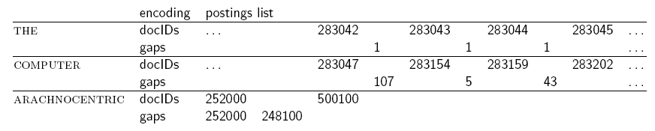
Three postings entries
Sec. 5.3

Slide 36
Variable length encoding
Sec. 5.3
Aim:
  For arachnocentric, we will use ~20 bits/gap entry
  For the, we will use ~1 bit/gap entry
If the average gap for a term is G, we want to use ~log₂G bits/gap entry
Key challenge: encode every integer (gap) with about as few bits as needed for that integer
This requires a variable length encoding
Variable length codes achieve this by using short codes for small numbers

Slide 37
Variable Byte (VB) codes
Sec. 5.3
For a gap value G, we want to use close to the fewest bytes needed to hold log₂ G bits
Begin with one byte to store G and dedicate 1 bit in it to be a continuation bit c
If G ≤127, binary-encode it in the 7 available bits and set c =1
Else encode G’s lower-order 7 bits and then use additional bytes to encode the higher order bits using the same algorithm
At the end set the continuation bit of the last byte to 1 (c =1) – and for the other bytes c = 0

Slide 38
Example
Sec. 5.3
docIDs | 824 | 829 | 215406
gaps |  | 5 | 214577
VB code | 00000110 10111000 | 10000101 | 00001101 00001100 10110001
Postings stored as the byte concatenation
000001101011100010000101000011010000110010110001
Key property: VB-encoded postings are
uniquely prefix-decodable
For a small gap (5), VB
uses a whole byte

Slide 39
Other variable unit codes
Sec. 5.3
Instead of bytes, we can also use a different “unit of alignment”: 32 bits (words), 16 bits, 4 bits (nibbles)
Variable byte alignment wastes space if you have many small gaps – nibbles do better in such cases
Variable byte codes:
  Used by many commercial/research systems
  Good low-tech blend of variable-length coding and sensitivity to computer memory alignment matches (vs. bit-level codes, which we look at next)
There is also recent work on word-aligned codes that pack a variable number of gaps into one word

Slide 40
Unary code
Represent n as n 1s with a final 0
Unary code for 3 is 1110
Unary code for 40 is
11111111111111111111111111111111111111110
Unary code for 80 is:
111111111111111111111111111111111111111111111111111111111111111111111111111111110
This doesn’t look promising, but….

Slide 41
Gamma codes
Sec. 5.3
We can compress better with bit-level codes
  The Gamma code is the best known of these
Represent a gap G as a pair length and offset
offset is G in binary, with the leading bit cut off
  For example 13 → 1101 → 101
length is the length of offset
  For 13 (offset 101), this is 3
We encode length with unary code: 1110
Gamma code of 13 is the concatenation of length and offset: 1110101

Slide 42
Gamma code examples
Sec. 5.3
number | length | offset | γ-code
0 |  |  | none
1 | 0 |  | 0
2 | 10 | 0 | 10,0
3 | 10 | 1 | 10,1
4 | 110 | 00 | 110,00
9 | 1110 | 001 | 1110,001
13 | 1110 | 101 | 1110,101
24 | 11110 | 1000 | 11110,1000
511 | 111111110 | 11111111 | 111111110,11111111
1025 | 11111111110 | 0000000001 | 11111111110,0000000001

Slide 43
Gamma code properties
Sec. 5.3
G is encoded using 2 ⎣log G⎦ + 1 bits
  Length of offset is ⎣log G⎦ bits
  Length of length is ⎣log G⎦ + 1 bits
All gamma codes have an odd number of bits
Almost within a factor of 2 of best possible, log₂ G
Gamma code is uniquely prefix-decodable, like VB
Gamma code can be used for any distribution
Gamma code is parameter-free

Slide 44
Gamma seldom used in practice
Sec. 5.3
Machines have word boundaries – 8, 16, 32, 64 bits
  Operations that cross word boundaries are slower
Compressing and manipulating at the granularity of bits can be slow
Variable byte encoding is aligned and thus potentially more efficient
Regardless of efficiency, variable byte is conceptually simpler at little additional space cost

Slide 45
RCV1 compression
Sec. 5.3
Data structure | Size in MB
dictionary, fixed-width | 11.2
dictionary, term pointers into string | 7.6
with blocking, k = 4 | 7.1
with blocking & front coding | 5.9
collection (text, xml markup etc) | 3,600.0
collection (text) | 960.0
Term-doc incidence matrix | 40,000.0
postings, uncompressed (32-bit words) | 400.0
postings, uncompressed (20 bits) | 250.0
postings, variable byte encoded | 116.0
postings, γ−encoded | 101.0

Slide 46
Index compression summary
Sec. 5.3
We can now create an index for highly efficient Boolean retrieval that is very space efficient
  Only 4% of the total size of the collection
  Only 10-15% of the total size of the text in the collection
However, we’ve ignored positional information
Hence, space savings are less for indexes used in practice
  But techniques substantially the same

Slide 47
Resources for today’s lecture
Ch. 5
IIR 5
MG 3.3, 3.4.
F. Scholer, H.E. Williams and J. Zobel. 2002. Compression of Inverted Indexes For Fast Query Evaluation. Proc. ACM-SIGIR 2002.
  Variable byte codes
V. N. Anh and A. Moffat. 2005. Inverted Index Compression Using Word-Aligned Binary Codes. Information Retrieval 8: 151–166.
  Word aligned codes

