Slide 1
Introduction to the Distributed Platforms & MapReduce
Slides modified from CS246: Mining Massive Datasets
Jure Leskovec, Stanford University

Slide 2
Outline
Motivation
Why distribution?
Distributed computing for data mining
Scalability
Popular distributed platforms
Hadoop
Spark

Slide 3
Why Distribution?

Slide 4
Motivation
Why distribution?
Big data: volume, velocity, variety
We need more storage space
Space efficiency
We need more computing power
Time efficiency
We need more I/O throughput
Inevitable because of the computer architecture

Slide 5
Divide and Conquer
“Work”
Partition
w₁
w₂
w₃
worker
worker
worker
r₁
r₂
r₃
Combine
“Result”

Slide 6
Parallelization Challenges
How do we assign work units to workers?
What if we have more work units than workers?
What if workers need to share partial results?
How do we aggregate partial results?
How do we know all the workers have finished?
What if workers die?
What’s the common theme of all these problems?

Slide 7
Common Theme?
Parallelization problems arise from:
Communication between workers (e.g., to exchange state)
Access to shared resources (e.g., data)
Thus, we need a synchronization mechanism

Slide 8
Managing Multiple Workers
Difficult because
We don’t know the order in which workers run
We don’t know when workers interrupt each other
We don’t know when workers need to communicate partial results
We don’t know the order in which workers access shared data
Thus, we need:
Semaphores (lock, unlock)
Conditional variables (wait, notify, broadcast)
Barriers
Still, lots of problems:
Deadlock, livelock, race conditions...
Dining philosophers, sleeping barbers, cigarette smokers...
Moral of the story: be careful!

Slide 9
Current Tools
Programming models
Shared memory (pthreads)
Message passing (MPI)
Design Patterns
Master-slaves
Producer-consumer flows
Shared work queues
Shared Memory
Message Passing
Memory
P₁
P₂
P₃
P₄
P₅
P₁
P₂
P₃
P₄
P₅
producer
consumer
master
work queue
slaves
producer
consumer

Slide 10
Where the rubber meets the road
Concurrency is difficult to reason about
Concurrency is even more difficult to reason about
At the scale of datacenters and across datacenters
In the presence of failures
In terms of multiple interacting services
Not to mention debugging…
The reality:
Lots of one-off solutions, custom code
Write your own dedicated library, then program with it
Burden on the programmer to explicitly manage everything

Slide 11
“Big Ideas”
Scale “out”, not “up”
Limits of SMP and large shared-memory machines
Move processing to the data
Cluster has limited bandwidth
Process data sequentially, avoid random access
Seeks are expensive, disk throughput is reasonable
Seamless scalability
From the mythical man-month to the tradable machine-hour

Slide 12
Scaling “up” vs. “out”
No single machine is large enough
Smaller cluster of large SMP machines vs. larger cluster of commodity machines (e.g., 16 128-core machines vs. 128 16-core machines)
Nodes need to talk to each other!
Intra-node latencies: ~100 ns
Inter-node latencies: ~100 μs

Slide 13
Distributed Computing for Data Mining

Slide 14
Single Node Architecture
CPU
Machine Learning, Statistics
Memory
“Classical” Data Mining
Disk

Slide 15
Motivation: Google Example
20+ billion web pages x 20KB = 400+ TB
1 computer reads 30-35 MB/sec from disk
~4 months to read the web
~1,000 hard drives to store the web
Takes even more to do something useful with the data!
Today, a standard architecture for such problems is emerging:
Cluster of commodity Linux nodes
Commodity network (ethernet) to connect them

Slide 16
Cluster Architecture
2-10 Gbps backbone between racks
1 Gbps between
any pair of nodes
in a rack
Switch
Switch
Switch
CPU
CPU
CPU
CPU
Mem
…
Mem
Mem
…
Mem
Disk
Disk
Disk
Disk
Each rack contains 16-64 nodes
In 2011 it was guestimated that Google had 1M machines, http://bit.ly/Shh0RO

Slide 17
Large-scale Computing
Large-scale computing for data mining problems on commodity hardware
Challenges:
How do you distribute computation?
How can we make it easy to write distributed programs?
Machines fail:
One server may stay up 3 years (1,000 days)
If you have 1,000 servers, expect to loose 1/day
With 1M machines 1,000 machines fail every day!

Slide 18
An Idea and a Solution
Issue: Copying data over a network takes time
Idea:
Bring computation to data
Store files multiple times for reliability
Spark/Hadoop address these problems
Storage Infrastructure – File system
Google: GFS. Hadoop: HDFS
Programming model
MapReduce
Spark

Slide 19
Storage Infrastructure
Problem:
If nodes fail, how to store data persistently?
Answer:
Distributed File System
Provides global file namespace
Typical usage pattern:
Huge files (100s of GB to TB)
Data is rarely updated in place
Reads and appends are common

Slide 20
Distributed File System
Chunk servers
File is split into contiguous chunks
Typically each chunk is 16-64MB
Each chunk replicated (usually 2x or 3x)
Try to keep replicas in different racks
Master node
a.k.a. Name Node in Hadoop’s HDFS
Stores metadata about where files are stored
Might be replicated
Client library for file access
Talks to master to find chunk servers
Connects directly to chunk servers to access data

Slide 21
Distributed File System
Reliable distributed file system
Data kept in “chunks” spread across machines
Each chunk replicated on different machines
Seamless recovery from disk or machine failure
C₀
C₁
D₀
C₁
C₂
C₅
C₀
C₅
…
C₅
Chunk server 1
C₂
C₅
Chunk server 2
C₃
D₀
Chunk server 3
D₁
D₀
Chunk server N
C₂
Bring computation directly to the data!
Chunk servers also serve as compute servers
Notes:
21

Slide 22
Google File System (GFS) Architecture

Slide 23
HDFS Architecture – Master/Slave

Slide 24
Typical Big Data Problem
Iterate over a large number of records
Extract something of interest from each
Shuffle and sort intermediate results
Aggregate intermediate results
Generate final output
Map
Reduce
Key idea: provide a functional abstraction for these two operations
(Dean and Ghemawat, OSDI 2004)

Slide 25
Roots in Functional Programming
Map
f
f
f
f
f
Fold
g
g
g
g
g

Slide 26
Programming Model
MapReduce is a style of programming designed for:
Easy parallel programming
Invisible management of hardware and software failures
Easy management of very-large-scale data
It has several implementations, including Hadoop, Spark (used in this class), Flink, and the original Google implementation just called “MapReduce”

Slide 27
MapReduce Implementations
Google has a proprietary implementation in C++
Bindings in Java, Python
Hadoop is an open-source implementation in Java
Development led by Yahoo, now an Apache project
Used in production at Yahoo, Facebook, Twitter, LinkedIn, Netflix, …
The de facto big data processing platform
Large and expanding software ecosystem
Lots of custom research implementations
For GPUs, cell processors, etc.

Slide 28
User Program
(1) submit
Master
(2) schedule map
(2) schedule reduce
worker
split 0
(6) write
output
file 0
split 1
(5) remote read
worker
split 2
(3) read
(4) local write
split 3
worker
split 4
worker
output
file 1
worker
Input
files
Map
phase
Intermediate files
(on local disk)
Reduce
phase
Output
files
Adapted from (Dean and Ghemawat, OSDI 2004)

Slide 29
MapReduce: Overview
3 steps of MapReduce
Map:
Apply a user-written Map function to each input element
Mapper applies the Map function to a single element
Many mappers grouped in a Map task (the unit of parallelism)
The output of the Map function is a set of 0, 1, or more key-value pairs.
Group by key: Sort and shuffle
System sorts all the key-value pairs by key, and outputs key-(list of values) pairs
Reduce:
User-written Reduce function is applied to each key-(list of values)
Outline stays the same, Map and Reduce change to fit the problem

Slide 30
MapReduce: The Map Step
Input
key-value pairs
Intermediate
key-value pairs
k
v
map
k
v
k
v
map
k
v
k
v
…
…
k
v
k
v

Slide 31
MapReduce: The Reduce Step
Output
key-value pairs
Intermediate
key-value pairs
Key-value groups
reduce
k
v
k
v
v
v
k
v
Group
by key
reduce
k
v
k
v
v
k
v
k
v
…
…
…
k
v
k
v
k
v

Slide 32
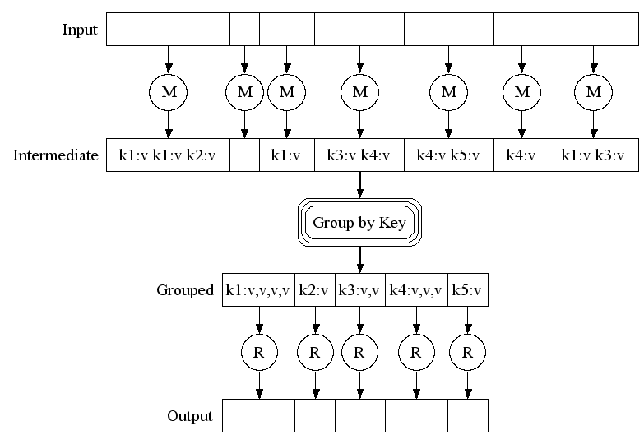
Map-Reduce: A diagram
MAP:
Read input and produces a set of key-value pairs
Group by key:
Collect all pairs with same key
(Hash merge, Shuffle, Sort, Partition)
Reduce:
Collect all values belonging to the key and output

Slide 33
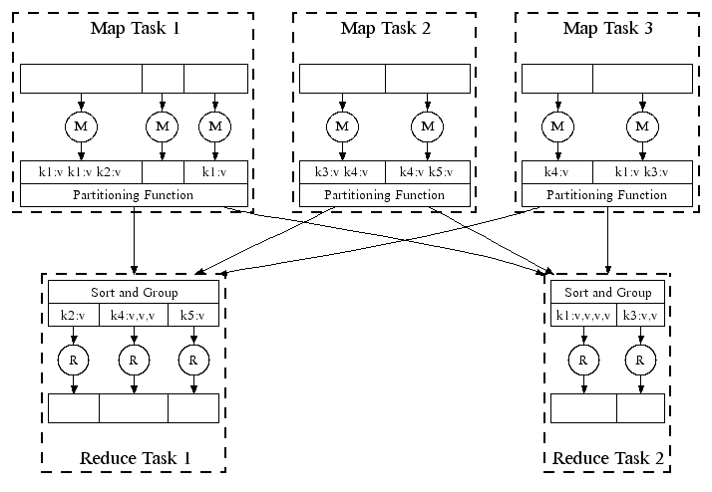
Map-Reduce: In Parallel
All phases are distributed with many tasks doing the work

Slide 34
MapReduce Pattern
key-value
pairs
Input
Output
Mappers
Reducers

Slide 35
Example: Word Counting
Example MapReduce task:
We have a huge text document
Count the number of times each distinct word appears in the file
Many applications of this:
Analyze web server logs to find popular URLs
Statistical machine translation:
Need to count number of times every 5-word sequence occurs in a large corpus of documents

Slide 36
MapReduce: Word Counting
Provided by the programmer
Provided by the programmer
MAP:
Read input and produces a set of key-value pairs
Group by key:
Collect all pairs with same key
Reduce:
Collect all values belonging to the key and output
The crew of the space shuttle Endeavor recently returned to Earth as ambassadors, harbingers of a new era of space exploration. Scientists at NASA are saying that the recent assembly of the Dextre bot is the first step in a long-term space-based man/mache partnership. '"The work we're doing now -- the robotics we're doing -- is what we're going to need ……………………..
(The, 1)
(crew, 1)
(of, 1)
(the, 1)
(space, 1)
(shuttle, 1)
(Endeavor, 1)
(recently, 1)
….
(crew, 1)
(crew, 1)
(space, 1)
(the, 1)
(the, 1)
(the, 1)
(shuttle, 1)
(recently, 1)
…
(crew, 2)
(space, 1)
(the, 3)
(shuttle, 1)
(recently, 1)
…
Sequentially read the data
Only sequential reads
Big document
(key, value)
(key, value)
(key, value)

Slide 37
Word Count Using MapReduce
map(key, value):
// key: document name; value: text of the document
for each word w in value:
emit(w, 1)
reduce(key, values):
// key: a word; value: an iterator over counts
result = 0
for each count v in values:
result += v
emit(key, result)

Slide 38
Map-Reduce
Programmer specifies:
Map and Reduce and input files
Workflow:
Read inputs as a set of key-value-pairs
Map transforms input kv-pairs into a new set of k'v'-pairs
Sorts & Shuffles the k'v'-pairs to output nodes
All k’v’-pairs with a given k’ are sent to the same reduce
Reduce processes all k'v'-pairs grouped by key into new k''v''-pairs
Write the resulting pairs to files
All phases are distributed with many tasks doing the work
Input 0
Input 1
Input 2
Map 0
Map 1
Map 2
Shuffle
Reduce 0
Reduce 1
Out 0
Out 1

Slide 39
MapReduce: Environment
MapReduce environment takes care of:
Partitioning the input data
Scheduling the program’s execution across a set of machines
Performing the group by key step
In practice this is the bottleneck
Handling machine failures
Managing required inter-machine communication

Slide 40
Dealing with Failures
Map worker failure
Map tasks completed or in-progress at worker are reset to idle and rescheduled
Reduce workers are notified when map task is rescheduled on another worker
Reduce worker failure
Only in-progress tasks are reset to idle and the reduce task is restarted

Slide 41
Putting everything together…
namenode
job submission node
namenode daemon
jobtracker
tasktracker
tasktracker
tasktracker
datanode daemon
datanode daemon
datanode daemon
Linux file system
Linux file system
Linux file system
…
…
…
slave node
slave node
slave node
(Not Quite… We’ll come back to YARN later)

Slide 42
Major Differences between Hadoop 1 and 2
HDFS Federation
Resource manager YARN

Slide 43
Hadoop 2: HDFS Federation
Two major components in HDFS
Namespaces
Blocks storage service
Hadoop 1
A single namenode manages the entire namespace
HDFS federation
Multiple namenode servers manage namespaces
Horizontal scaling, performance improvement, multiple namespaces

Slide 44
Hadoop 2: YARN
Brings significant performance improvements for some applications
Supports additional processing models
Implements a more flexible execution engine

Slide 45
YARN: from Hadoop 2

Slide 46
What is YARN?
A resource manager separated from MapReduce in Hadoop 1
The operating system of Hadoop
Managing and monitoring workloads
Maintaining a multi-tenant environment
Implementing security controls
Managing high-availability features of Hadoop
No longer limited to the I/O intensive, high-latency MapReduce model

Slide 47
Spark

Slide 48
Problems with MapReduce
Two major limitations of MapReduce:
Difficultly of programming directly in MR
Many problems aren’t easily described as map-reduce
Performance bottlenecks, or batch not fitting the use cases
Persistence to disk typically slower than in-memory work
In short, MR doesn’t compose well for large applications
Many times one needs to chain multiple map-reduce steps

Slide 49
Data-Flow Systems
MapReduce uses two “ranks” of tasks: One for Map, the second for Reduce
Data flows from the first rank to the second
Data-Flow Systems generalize this in two ways:
Allow any number of tasks/ranks
Allow functions other than Map and Reduce
As long as data flow is in one direction only, we can have the blocking property and allow recovery of tasks rather than whole jobs

Slide 50
Spark: Most Popular Data-Flow System
Expressive computing system, not limited to the map-reduce model
Additions to MapReduce model:
Fast data sharing
Avoids saving intermediate results to disk
Caches data for repetitive queries (e.g. for machine learning)
General execution graphs (DAGs)
Richer functions than just map and reduce
Compatible with Hadoop

Slide 51
Spark Architecture

Slide 52
Components
Spark applications
Independent sets of processes on a cluster, coordinated by the SparkContext object in main (Driver) program
Cluster managers
Allocate resources across applications
Executors
Processes that run computations and store data
Spark sends your application code (JAR or python files) to executors, and SparkContext sends tasks to executors to run

Slide 53
Note about the architecture
Each application has its own executor processes
Benefit: isolating applications from each other
Cons: data cannot be shared across different applications without writing to external storage
Spark is agnostic to the underlying cluster manager
Driver program must listen for and accept incoming connections from its executors throughout its lifetime
Driver must be network addressable from the workers
Driver program should be run close to the worker nodes, since it schedules tasks on the cluster

Slide 54
Cluster Manager Types
Standalone: a simple cluster manager included in Spark
Faster job startup, but it doesn’t support communication with an HDFS secured with Kerberos authentication protocol
Apache Mesos: a general cluster manager that can also runs Hadoop MapReduce
A scalable and fault-tolerant “distributed systems kernel” written in C++, which also supports C++ and Python applications
It is actually a “scheduler of scheduler frameworks” because of its two-level scheduling architecture
Hadoop YARN: resource manager in Hadoop 2
YARN lets you run different types of Java applications, not just Spark
It also provides methods for isolating and prioritizing applications among users and organizations
The only cluster type that supports Kerberos-secured HDFS
You don’t have to install Spark on all nodes in the cluster

Slide 55
Spark Standalone Cluster
Two deploy modes for Spark Standalone cluster
Client mode: driver is launched in the same process as the client that submits the application
Cluster mode: driver is launched from one of the Worker processes in the cluster, and the client exits as soon as it fulfills its submission of application

Slide 56
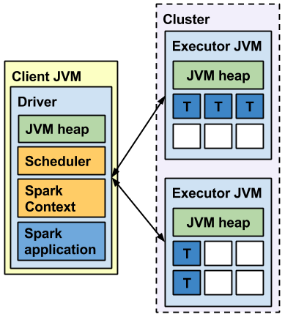
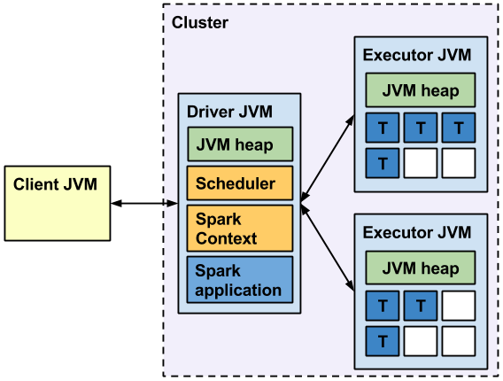
Client mode vs. Cluster mode

Slide 57
Spark on YARN cluster mode

Slide 58
Spark on YARN client mode

Slide 59
Spark: RDD
Key concept Resilient Distributed Dataset (RDD)
Partitioned collection of records
Generalizes (key-value) pairs
Spread across the cluster, Read-only
Caching dataset in memory
Different storage levels available
Fallback to disk possible
RDDs can be created from Hadoop, or by transforming other RDDs (you can stack RDDs)
RDDs are best suited for applications that apply the same operation to all elements of a dataset

Slide 60
Spark RDD Operations
Transformations build RDDs through deterministic operations on other RDDs:
Transformations include map, filter, join, union, intersection, distinct
Lazy evaluation: Nothing computed until an action requires it
Actions to return value or export data
Actions include count, collect, reduce, save
Actions can be applied to RDDs; actions force calculations and return values

Slide 61
Task Scheduler: General DAGs
A:
B:
F:
Stage 1
groupBy
C:
D:
E:
join
= RDD
Stage 2
map
filter
Stage 3
= cached partition
Supports general task graphs
Pipelines functions where possible
Cache-aware data reuse & locality
Partitioning-aware to avoid shuffles
Notes:
NOT a modified version of Hadoop

Slide 62
Data Analytics Software Stack

Slide 63
Problems Suited for MapReduce

Slide 64
Example: Host size
Suppose we have a large web corpus
Look at the metadata file
Lines of the form: (URL, size, date, …)
For each host, find the total number of bytes
That is, the sum of the page sizes for all URLs from that particular host
Other examples:
Link analysis and graph processing
Machine Learning algorithms

Slide 65
Example: Language Model
Statistical machine translation:
Need to count number of times every 5-word sequence occurs in a large corpus of documents
Very easy with MapReduce:
Map:
Extract (5-word sequence, count) from document
Reduce:
Combine the counts

Slide 66
Example: Join By Map-Reduce
Compute the natural join R(A,B) ⋈ S(B,C)
R and S are each stored in files
Tuples are pairs (a,b) or (b,c)
A | B
a₁ | b₁
a₂ | b₁
a₃ | b₂
a₄ | b₃
B | C
b₂ | c₁
b₂ | c₂
b₃ | c₃
A | C
a₃ | c₁
a₃ | c₂
a₄ | c₃
⋈
=
S
R

Slide 67
Map-Reduce Join
Use a hash function h from B-values to 1...k
A Map process turns:
Each input tuple R(a,b) into key-value pair (b,(a,R))
Each input tuple S(b,c) into (b,(c,S))
Map processes send each key-value pair with key b to Reduce process h(b)
Hadoop does this automatically; just tell it what k is
Each Reduce process matches all the pairs (b,(a,R)) with all (b,(c,S)) and outputs (a,b,c)

Slide 68
Problems NOT suitable for MapReduce
MapReduce is great for:
Problems that require sequential data access
Large batch jobs (not interactive, real-time)
MapReduce is inefficient for problems where random (or irregular) access to data required:
Graphs
Interdependent data
Machine learning
Comparisons of many pairs of items

Slide 69
Cost Measures for Algorithms
In MapReduce we quantify the cost of an algorithm using
Communication cost = total I/O of all processes
Elapsed communication cost = max of I/O along any path
(Elapsed) computation cost analogous, but count only running time of processes
Note that here the big-O notation is not the most useful (adding more machines is always an option)

Slide 70
User Program
(1) submit
Master
(2) schedule map
(2) schedule reduce
worker
split 0
(6) write
output
file 0
split 1
(5) remote read
worker
split 2
(3) read
(4) local write
split 3
worker
split 4
worker
output
file 1
worker
Input
files
Map
phase
Intermediate files
(on local disk)
Reduce
phase
Output
files
Adapted from (Dean and Ghemawat, OSDI 2004)

Slide 71
Example: Cost Measures
For a map-reduce algorithm:
Communication cost = input file size + 2 × (sum of the sizes of all files passed from Map processes to Reduce processes) + the sum of the output sizes of the Reduce processes.
Elapsed communication cost is the sum of the largest input + output for any map process, plus the same for any reduce process

Slide 72
What Cost Measures Mean
Either the I/O (communication) or processing (computation) cost dominates
Ignore one or the other
Total cost tells what you pay in rent from your friendly neighborhood cloud
Elapsed cost is wall-clock time using parallelism

Slide 73
Cost of Map-Reduce Join
Total communication cost = O(|R|+|S|+|R ⋈ S|)
Elapsed communication cost = O(s)
We’re going to pick k and the number of Map processes so that the I/O limit s is respected
We put a limit s on the amount of input or output that any one process can have. s could be:
What fits in main memory
What fits on local disk
With proper indexes, computation cost is linear in the input + output size
So computation cost is like comm. cost

Slide 74
Thanks for Your Attention!

Slide 75
References
Jure Leskovec, Anand Rajaraman, Jeffrey David Ullman, Mining of Massive Datasets, 3rd Edition, Cambridge University Press, Feb. 2020. (Ch.1-2)
Slides from Stanford CS246 “Mining Massive Datasets” (by Jure Leskovec)
Jimmy Lin and Chris Dyer, “Data-Intensive Text Processing with MapReduce”. (Ch.1-2)
Slides from Jimmy Lin’s “Big Data Infrastructure” course, Univ. Maryland (and Univ. Waterloo)

Slide 76
References
Papers:
Google File System (GFS)
Sanjay Ghemawat, Howard Gobioff, Shun-Tak Leung, The Google File System, Proceedings of the 19th ACM Symposium on Operating Systems Principles (SOSP), pp. 20-43, 2003.
MapReduce
Jeffrey Dean, Sanjay Ghemawat, MapReduce: Simplified Data Processing on Large Clusters, OSDI'04: Sixth Symposium on Operating System Design and Implementation, pp. 137-150, 2004.
BigTable
Fay Chang, Jeffrey Dean, Sanjay Ghemawat, Wilson C. Hsieh, Deborah A. Wallach, Mike Burrows, Tushar Chandra, Andrew Fikes, Robert E. Gruber, 7th USENIX Symposium on Operating Systems Design and Implementation (OSDI), pp. 205-218, 2006

